Slide 1
Addressing the Needs of Children, Youth and Families for Summer Opportunities in Alachua County

Slide 2
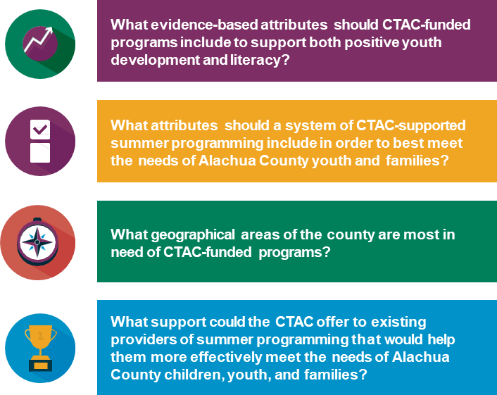
RESEARCH QUESTIONS: STATEMENT OF WORK

Slide 3
RECOMMENDATIONS
What evidence-based attributes should CTAC-funded programs include to support both positive youth development and literacy?
To build a sustainable, equitable system of quality summer programming we need a shared vision of quality summer programming for the community as a whole.
Construct a guiding evidence-based conceptual frame that specifies summer programming goals, standards, characteristics, attributes, and systemwide outcomes. Community stakeholders, especially youth, families, and vulnerable members of the community, should be invited to participate in creating and adopting this framework.
Partner with literacy experts and interventionists in Alachua County to prepare providers to incorporate evidence-based literacy practices into a range of summer programming opportunities.

Slide 4
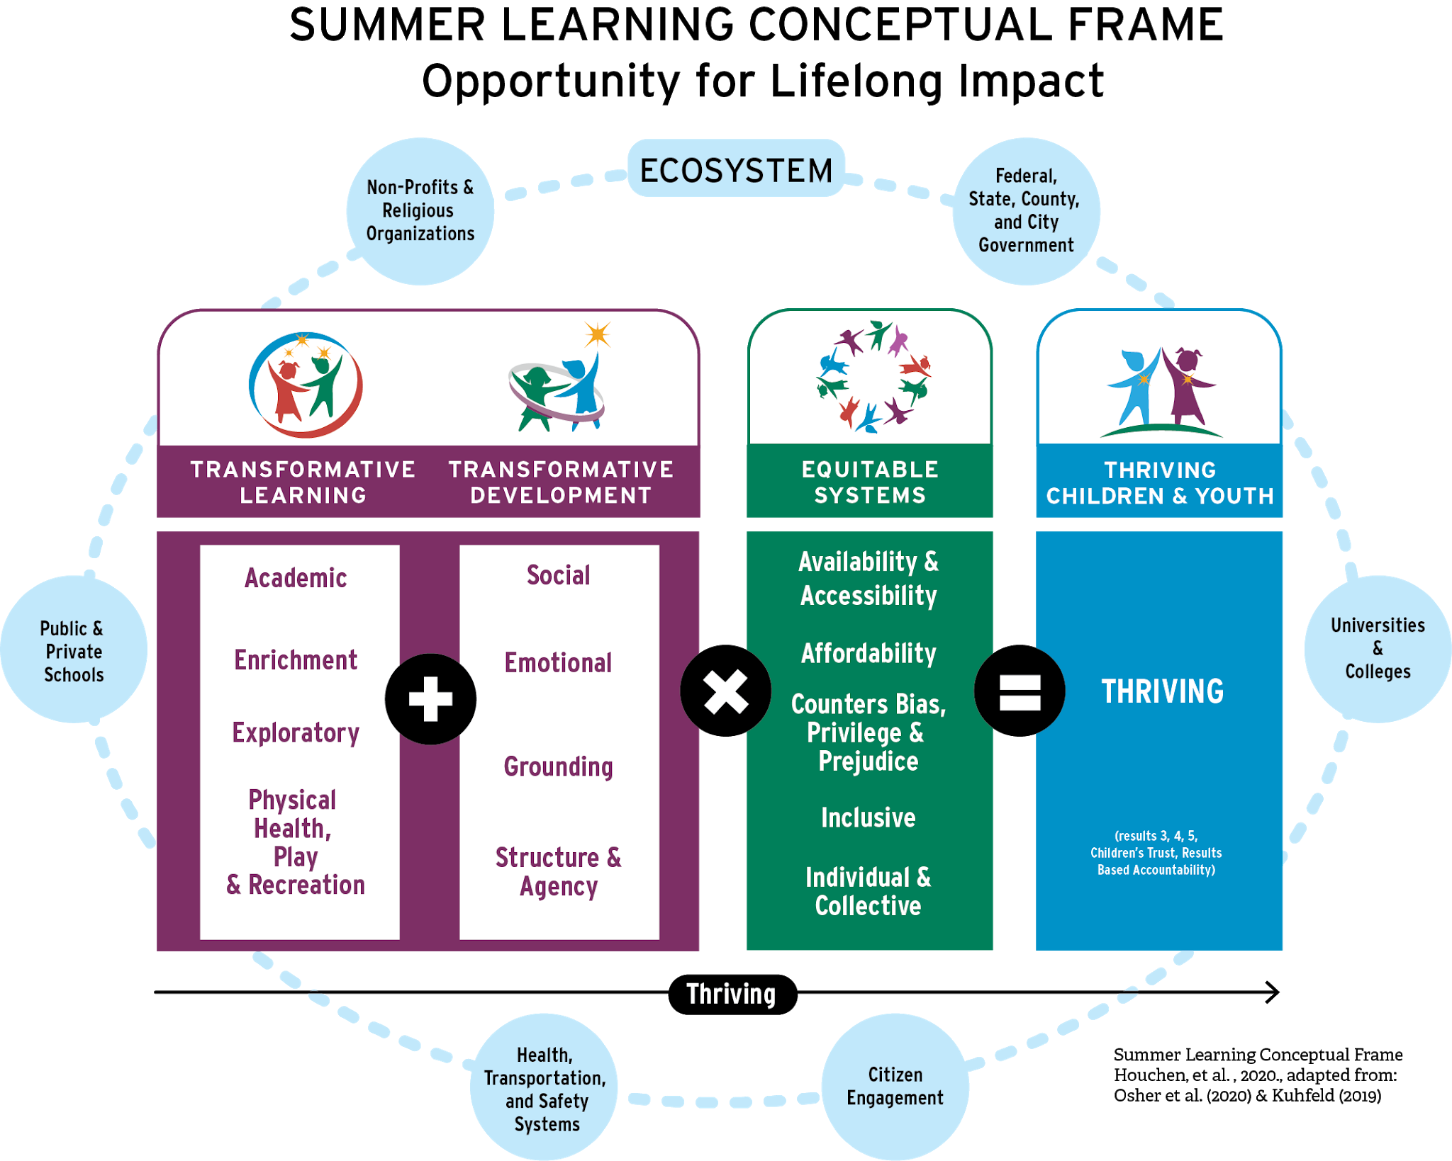
FRAMING SUMMER OPPORTUNITY

Slide 5
RECOMMENDATIONS
What attributes should a system of CTAC-supported summer programming include in order to best meet the needs of Alachua County families?
Families need more accessible, affordable, and inclusive summer programming.
Subsidize registration and other fees for parents according to families’ income levels and size and create funding structures designed for families with the lowest incomes.
Support the expansion of existing organizations’ services to accommodate more children per site and recruit new organizations to provide programming for children in underserved areas of the county.
Provide funds for providers specifically related to inclusion of children with disabilities and partner with organizations with expertise in working with children with disabilities.
Offer professional development opportunities for administration and staff of child- and youth-serving organizations.

Slide 6
RECOMMENDATIONS
What geographical areas of the county are most in need of CTAC-funded programs?
We need more comprehensive, nuanced data on summer programs. Invest in areas of high density and in the rural areas.
Collect data on child and youth services across the county, including age range served, activities provided, fees, capacity and location. The Trust should use this database to determine gaps in services and inform decisions about funding and other support.
Use this database to provide a public-facing information hub for families seeking summer programming for their children. This hub should provide information on registration processes and other relevant details.

Slide 7
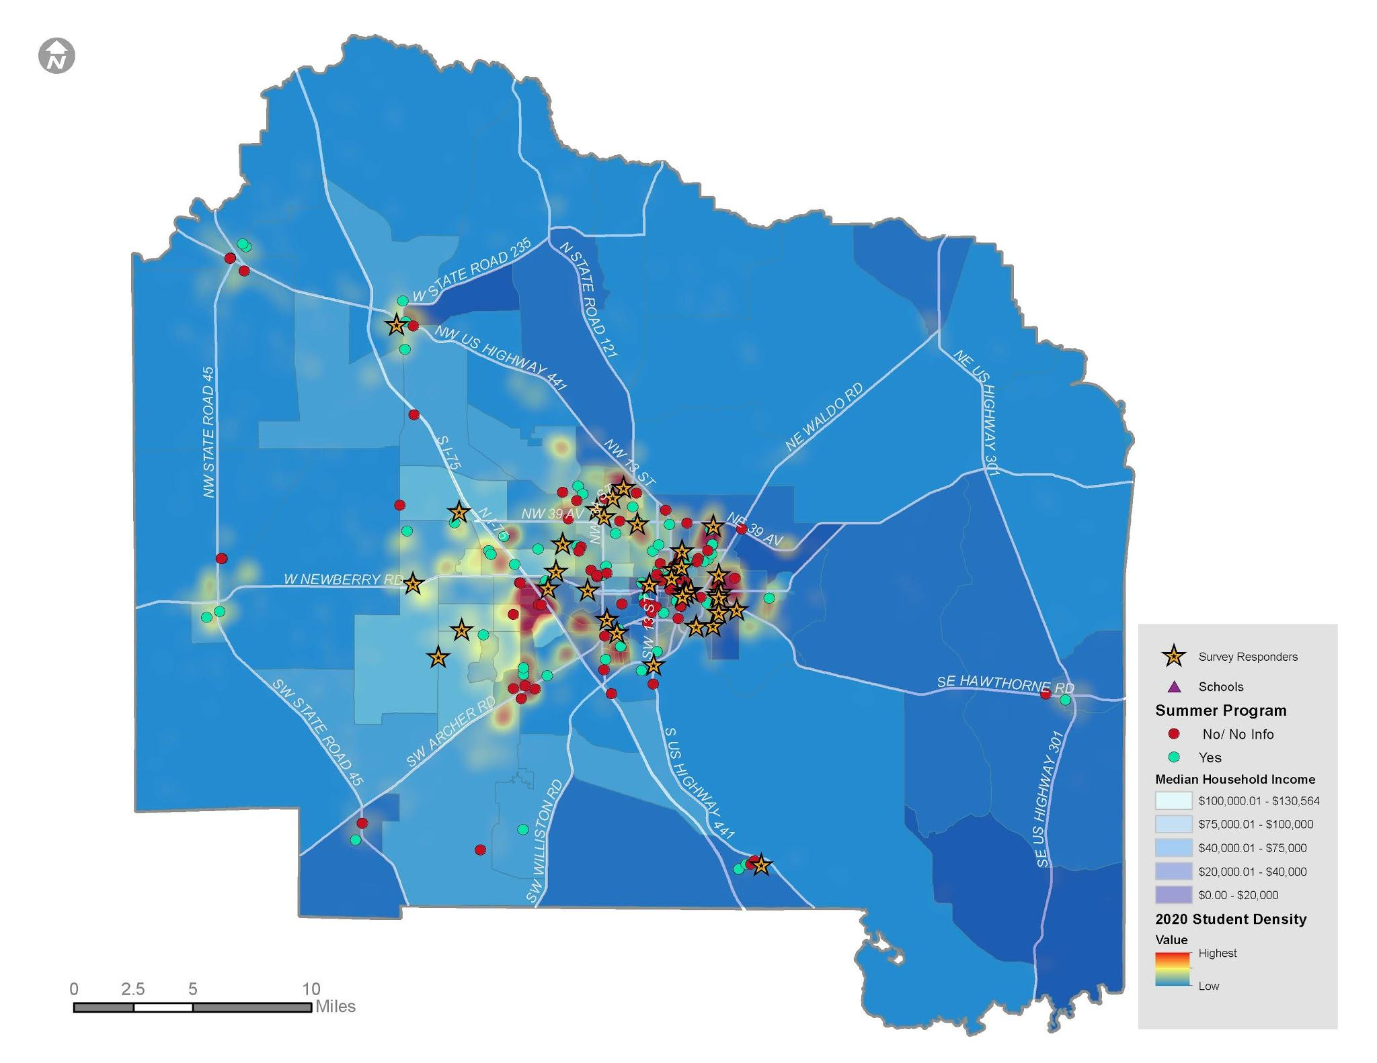
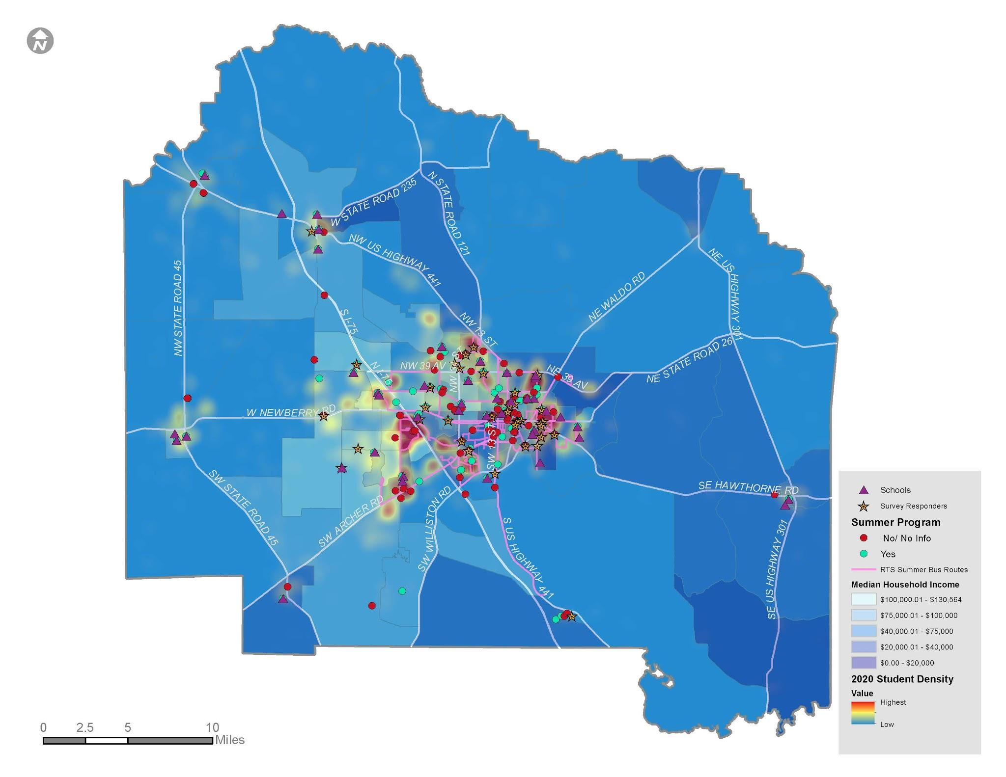
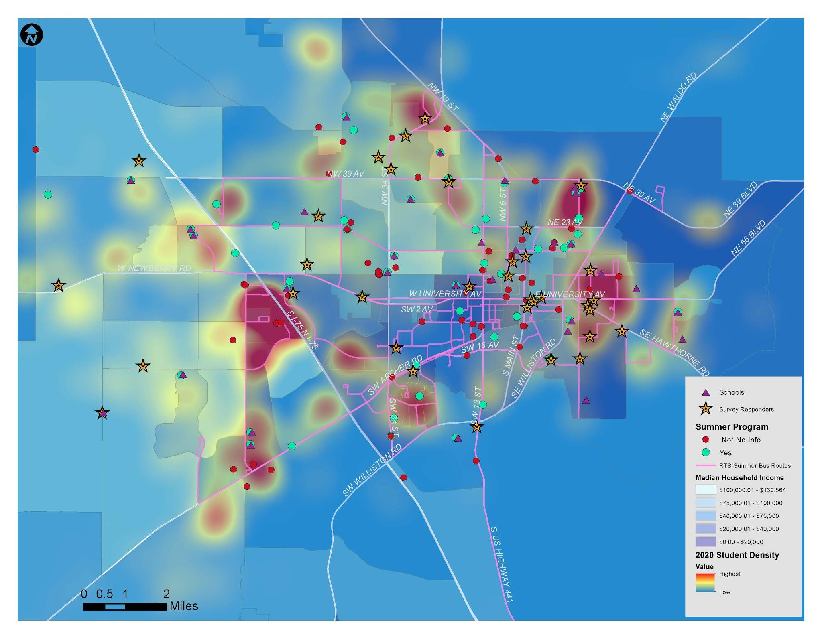
GIS DATA VISUALIZATION
Map 1
Alachua County Summer Provider Information
Map 2
City of Gainesville Summer Provider Information
Map 3
Alachua County Summer Provider with Transportation

Slide 8
RECOMMENDATIONS
What support could the CTAC offer to existing providers of summer programming that would help them more effectively meet the needs of Alachua County children, youth and families?
Providers need more streamlined, comprehensive support and increased funding.
Provide clear and sufficient information about the RFP process and application in a timely manner. Specifically, consider offering a single internal point of contact regarding the RFP for providers and creating an easy-to-use, accessible submission process
Ensure that funding criteria are explicit, and the process is transparent, fair, and clearly organized. Organize the RFP around a conceptual frame for summer programming and providing rubrics that define and elucidate the scoring process.
Provide technical assistance and grant education for providers to help them navigate the process

Slide 9
Questions?
The Youth Development Research–Practice Partnership (YDRPP) is an interdisciplinary team of researchers and practitioners with expertise in areas related to education, child and youth identity development, health and wellness. We believe that putting research into action can shape outcomes so that every child, adolescent and young adult thrives.
2

