Slide 1
Technical Advisory Committee to the Children’s Trust of Alachua County
Report to inform the Children’s Trust of Alachua County on the current state of child and family well-being data and to provide recommendations for the upcoming Strengths and Needs Assessment.
6-01-2020

Slide 2
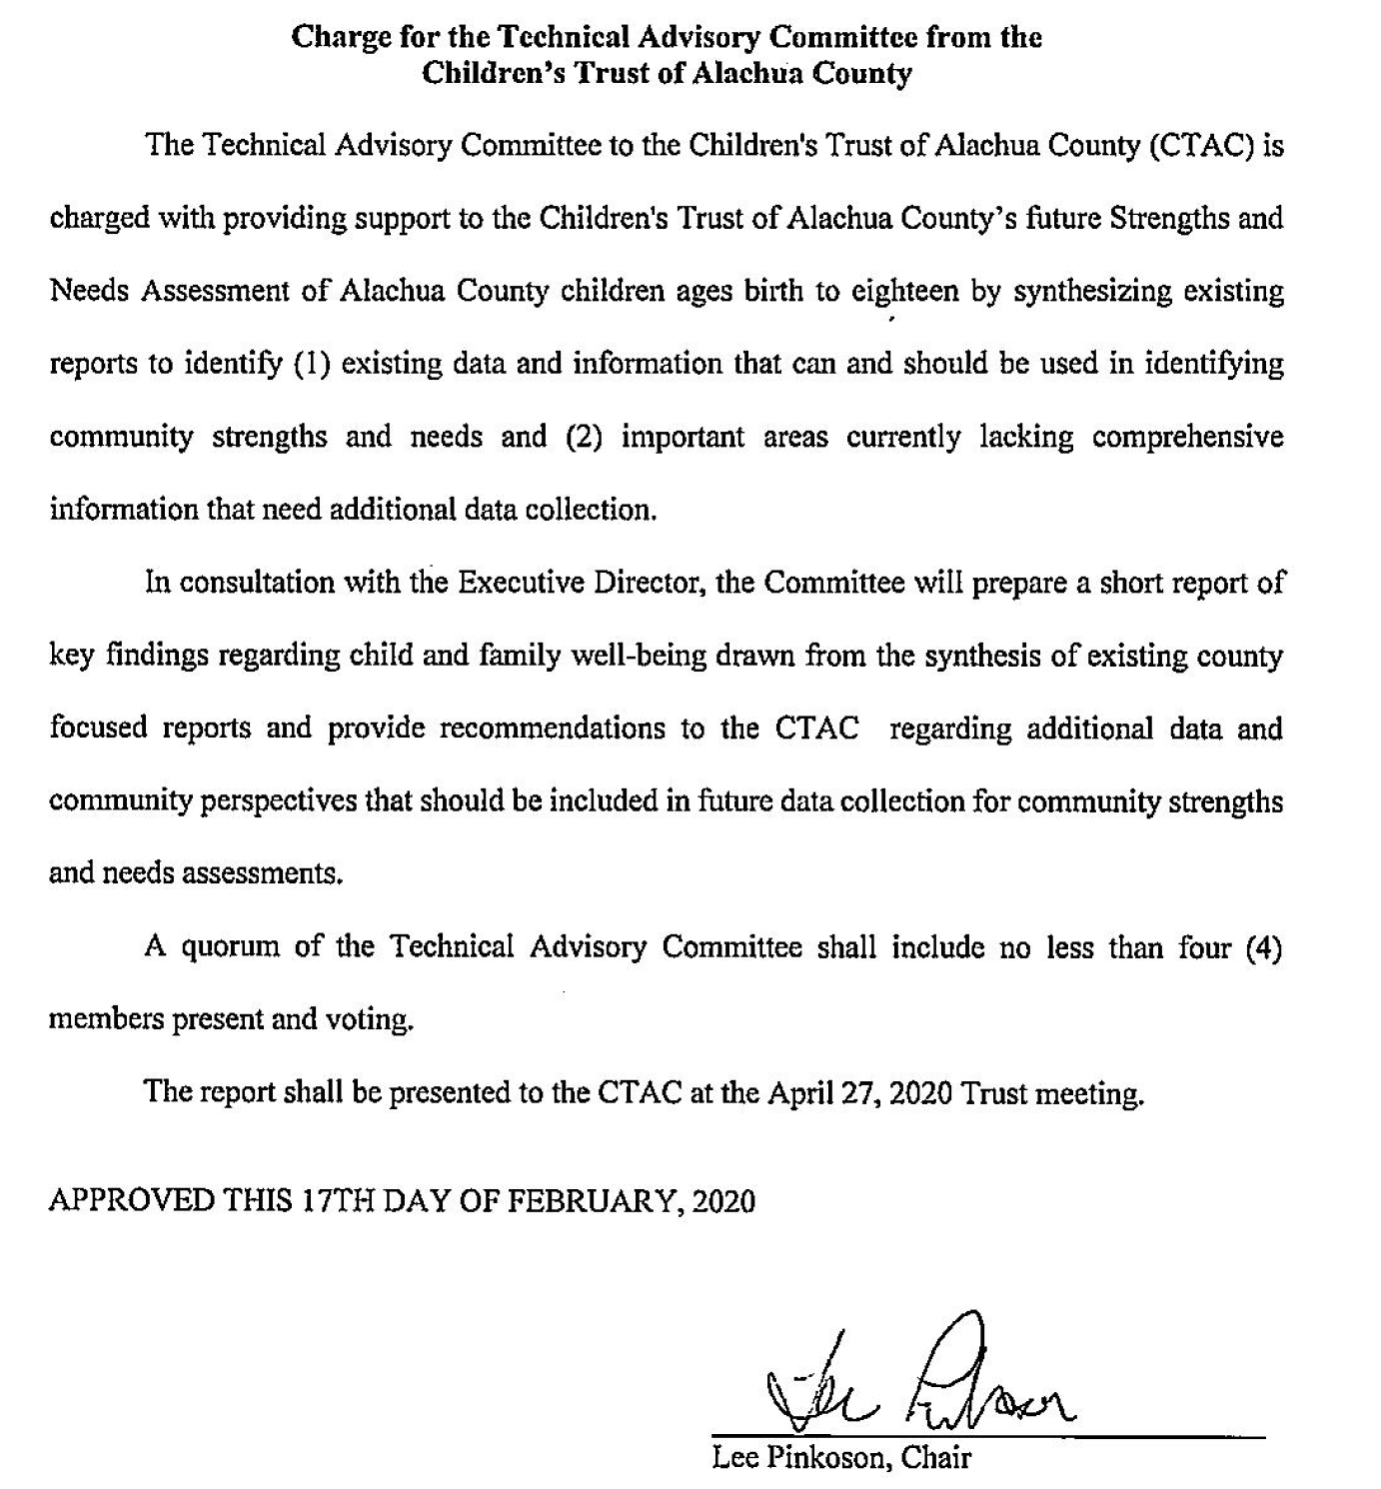

Slide 3
Committee Members
Naima Brown, Santa Fe College Student Affairs
Chris Busey, UF College of Education
Patricia Carroll, Partnership for Strong Families
Maureen Conroy, UF Anita Zucker Center
Roger Dolz, Alachua County Health Department
Jeff Feller, WellFlorida
Kate Fogarty, UF Department of Family, Youth, and Communities Science
Matthew Gurka, UF Institute for Child Health Policy
Diedre Houchen, UF Center for the Study of Race & Race Relations
Herman Knopf, Chair, UF Anita Zucker Center
Maggie Labarta*, Retired Behavioral Health CEO
Mae Quinn, UF Levin College of Law
Rosana Resende, UF Center for Latin American Studies
Carol Ruth, Partnership for Strong Families
Patricia Snyder*, UF Anita Zucker Center
* Member, Children’s Trust of Alachua County Board of Directors

Slide 4
Additional Support provided by…
Cindy Bishop, Alachua County Staff
Colin Murphy, Children’s Trust of Alachua County
Maya Schreiber, UF Anita Zucker Center

Slide 5
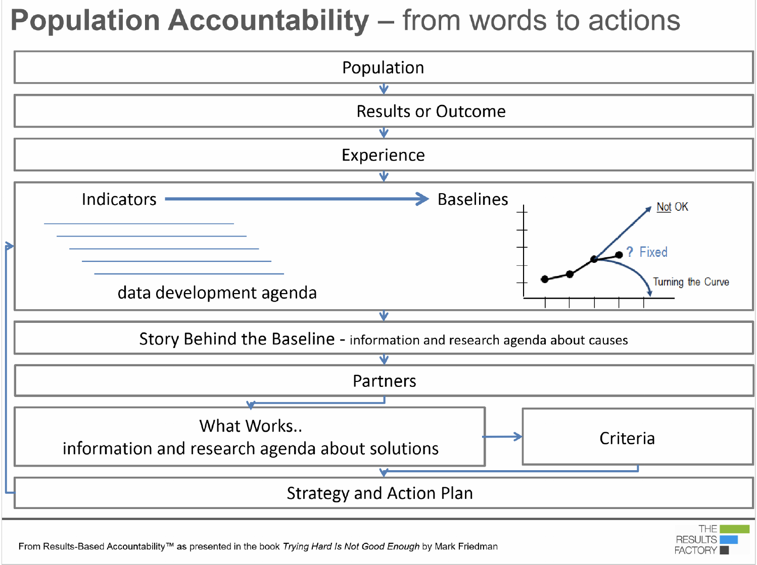
Current data
Data would like to have

Slide 6




Results Based Accountability
Population
Performance
Result
A condition of well-being for children, adults, families or communities.
Program
A program, organization, or service system
Department of Public Health
Foundation
Non-Profit
Grantee
Early Education Program
All children are born healthy and remain healthy
All children can learn what they need to be successful
All children have nurturing, supportive caregivers and relationships
All children live in a safe community
Indicator
A measure which helps quantify the achievement of a result.
Performance Measure
A measure of how well a program, agency or service system is working.
R
P
Rate of low-birth weight babies
Percent ready at K entry
Child Maltreatment
Crime rate
Three Types
How much did we do?
How well did we do it?
Is anyone better off?
I
PM

Slide 7
Activities
Bi-monthly meetings to discuss and identify a framework for meaningful results, indicators, and data that could be used by the Children’s Trust Board of Directors to understand and respond to the well-being of children and families in Alachua County.
All members, outside of scheduled committee meetings, collected and prepared resources and data to present to the committee for inclusion in the final deliverable.

Slide 8
Results Recommended by the Committee
Children in Alachua County are Effectively Supported When…
All children are born healthy and remain healthy.
All children can learn what they need to be successful.
All children have nurturing, supportive caregivers and relationships.
All children live in a safe community.

Slide 9
All children are connecting with and contributing to the community.
While initially considered a result, this might be more appropriately classified as a program characteristic.
Program performance data to collect include:
Youth’s ability to develop participation roles and have opportunities for leadership roles in the community
Youth’s ability to have agency and to build new skills
LGBTQUIA youth needs/other needs associated with sexuality and gender
Children referred for problems interacting with their peers
Teens in extracurricular and enriching activities

Slide 10
Insights
In Alachua County there are significant racial disparities in ALL result areas due to both programmatic and structural barriers.
While the percentage of children with health insurance in Alachua County is higher than the state rate, several indicators of health show a need for closer examination (e.g. Infant deaths, Child Obesity, STDs) of the health status of children in Alachua County.
Access to quality early childhood experiences is an issue, particularly in East Alachua County. This is reflected in maps of access and kindergarten readiness rates. Florida sponsors VPK supports for 4-5 year old children, but supports for younger children are missing from our system.
Access to information about socially and academically beneficial programs for children ages 5-18 is limited. Rates of Youth Arrested, STDs among 13-20 aged teens, and continued educational disparities highlight a need for further investigation, supports, and programming.
Everything that we think we know about systems of support will be challenged due to current public health crisis.

Slide 11
Florida Department of Health Resources
For Long-Term Indicator Tracking
The report of the committee includes indicators that can be tracked over time to understand children’s well-being in Alachua County.
Through our work the committee located existing resources, which are produced annually, that can be used to help track many of these recommended indicators:
Child Health Status Profile
School Aged Child and Adolescent Profile
* Indicates which measures have a corresponding measure on a DOH profile that can be used to track progress annually. The DOH profiles include a performance rating for each indicator reflected in quartiles (1st Quartile is good, 4th Quartile is bad). Current county performance in these quartiles will be displayed on graphs when available.

Slide 12
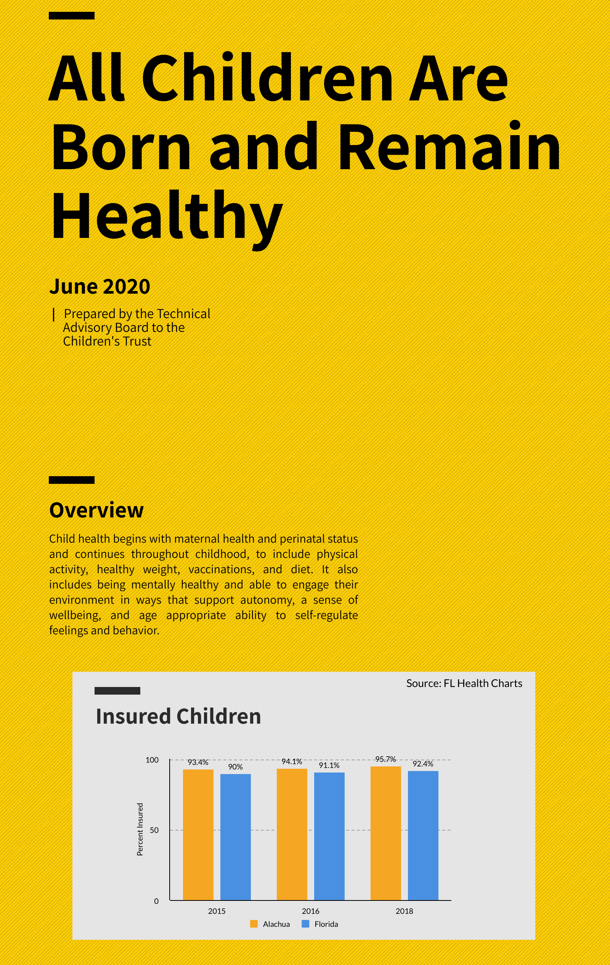
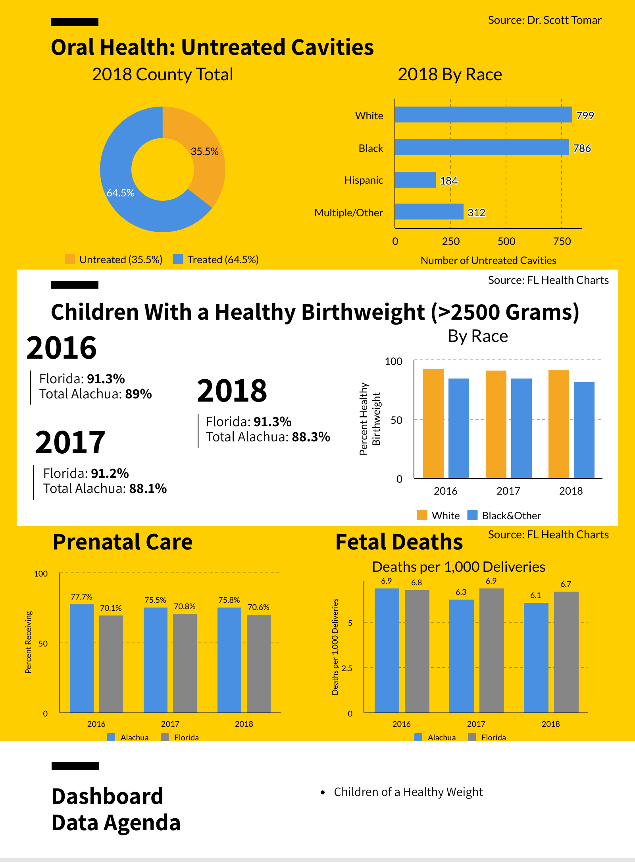
Access Here

Slide 13
All children are born healthy and remain healthy.
Indicators
Childhood Span
Insured Children*
Peri/Prenatal
Mothers receiving prenatal care*
Healthy Birthweight
Mothers initiating Breastfeeding
Fetal Deaths
SUIDS Deaths
Infant Deaths*
School Age
Oral Health
Children with access to a school nurse*
Teen mothers*
Sexually Transmitted Diseases (STDs)*
Hospitalizations for Self-Inflicted Injuries*
Hospitalizations for Eating Disorders*

Slide 14
1st Quartile
Source: FL Health Charts

Slide 15
Source: Dr. Scott Tomar

Slide 16
Source: Dr. Tomar Scott, UF College of Dentistry

Slide 17
Source: Kotelchuck Index

Slide 18
Source: FL Health Charts

Slide 19
Source: FL Health Charts

Slide 20
Source: FL Health Charts

Slide 21
Source: FL Health Charts

Slide 22
Source: FL Health Charts

Slide 23
4th Quartile
Source: FL Health Charts

Slide 24
1st Quartile
Source: FL Health Charts

Slide 25
1st Quartile
Source: FL Health Charts

Slide 26
Source: FL Health Charts

Slide 27
4th Quartile
Source: FL Health Charts

Slide 28
Source: FL Health Charts

Slide 29
2nd Quartile
1st Quartile

Slide 30
Hospitalizations for Self Inflicted Injuries
Ages 12-18
4th Quartile
Rate per 100,000 children
Alachua County: 170.2
State of Florida: 70.3
Alachua County’s rate is 2.42 times higher than state of Florida
Source: FL Health Charts

Slide 31
Hospitalizations for Eating Disorders
Ages 12-18
Rate per 100,000 Children
Alachua County: 84.3
State of Florida: 37.0
Alachua County’s rate is 2.28 times higher than the state of Florida
Source: FL Health Charts

Slide 32
All children are born healthy and remain healthy.
Data Development Agenda
Children can regulate emotions and behavior
Number of children referred to mental health services and able to access
Schools offering PE or period of physical activity to all students
Pre-K children who can self regulate and communicate their feelings/emotions
Young children who are a healthy weight
Physical activity available to youth during out of school programs

Slide 33
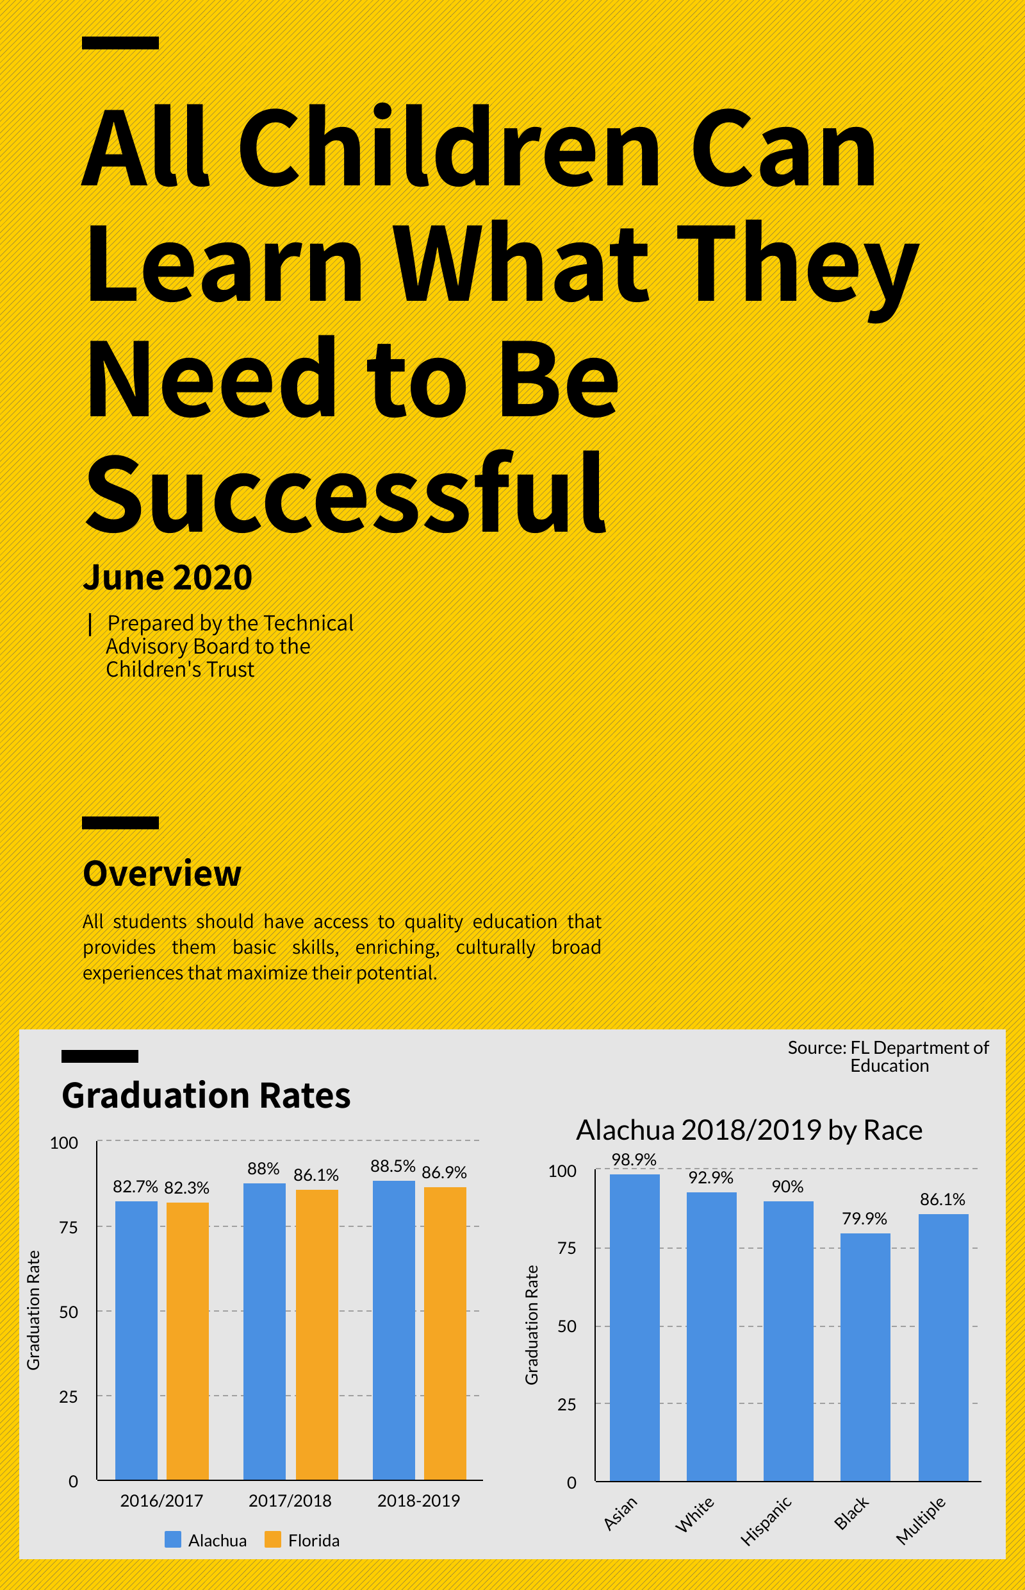
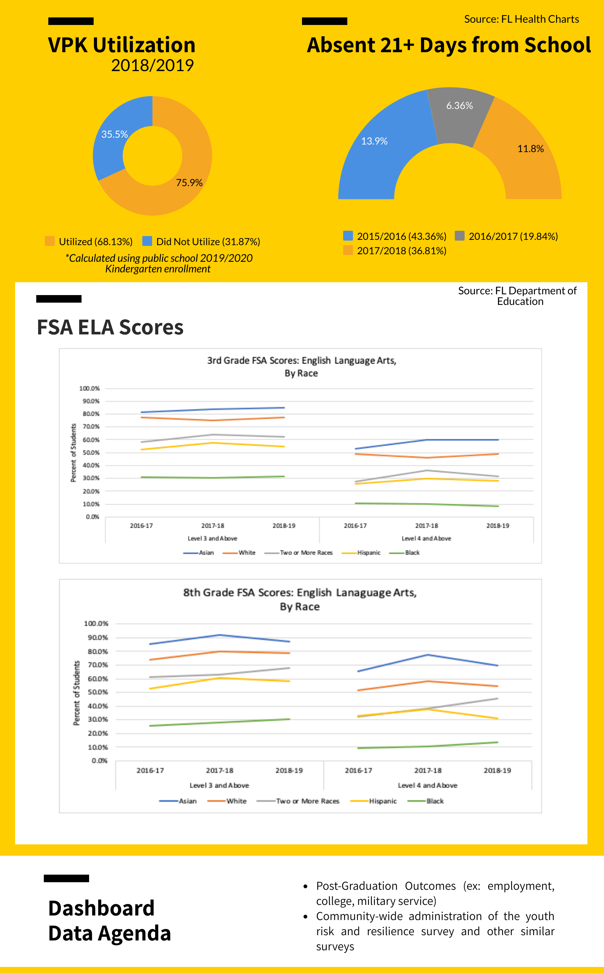
Access Here

Slide 34
All children can learn what they need to be successful.
Indicators
Early Childhood
Childcare accessibility
Children enrolled in Voluntary Pre-Kindergarten (VPK)
Kindergarten readiness rate
School Age
FSA ELA: 3rd, 8th, 10th Grades
FSA Mathematics: 3rd, 8th Grades
Out of School Suspensions K-12*
Students absent 21+ days from School*
High School graduation rates*

Slide 35
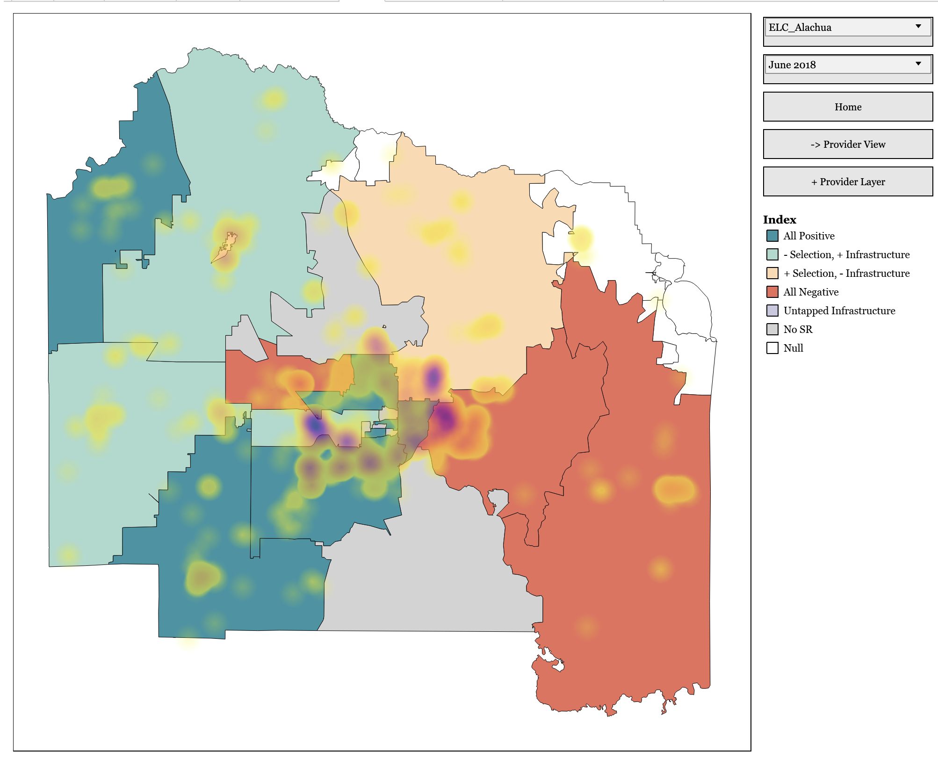
Florida Index of Child Care Access
Florida
School Readiness Program
Means-tested program to support access to quality child care
Family eligibility:
Families under 150%FPL
Working or in school
Provider participation:
Voluntary
Home-based and Center-based

Slide 36
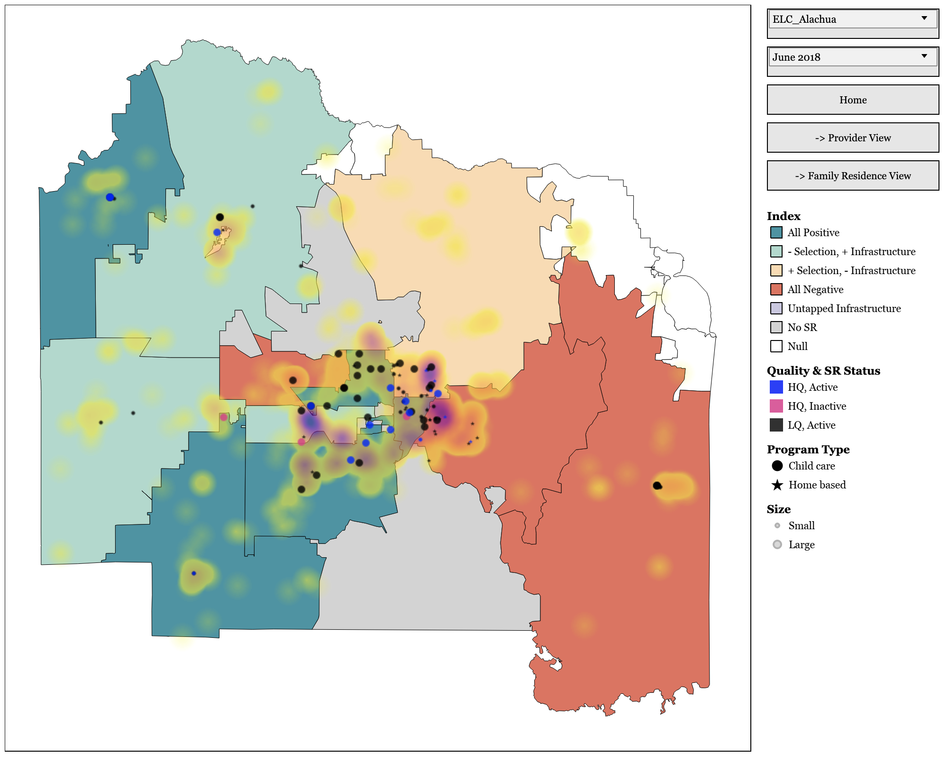
Florida Index of Child Care Access

Slide 37
Source: Florida Department of Education

Slide 38
FSA Performance Levels Florida Department of Education 2019
FSA ELA, Mathematics, and EOC Scale Scores and Performance Levels After the Spring 2015 baseline FSA administration, the Florida Department of Education (FDOE) conducted the standard setting process to establish the cut scores for the performance levels, also called achievement levels, for each grade and subject. The Florida State Board of Education adopted achievement level cut scores in January 2016 in State Board of Education Rule 6A-1.09422, Florida Administrative Code (FAC).
Level 5
Highly likely to excel in the next grade/course
Level 4
Likely to excel in the next grade/course
Level 3
May need additional support for the next grade/course
Level 2
Level 1
Likely to need substantial support for the next grade/course
Highly likely to need substantial support for the next grade/course

Slide 39
Source: Florida Department of Education

Slide 40
Source: Florida Department of Education

Slide 41
Source: Florida Department of Education

Slide 42
Source: Florida Department of Education

Slide 43
Source: Florida Department of Education

Slide 44
Source: Florida Department of Education

Slide 45
Source: Florida Department of Education

Slide 46
Source: Florida Department of Education

Slide 47
2nd Quartile
Source: Florida Department of Education

Slide 48
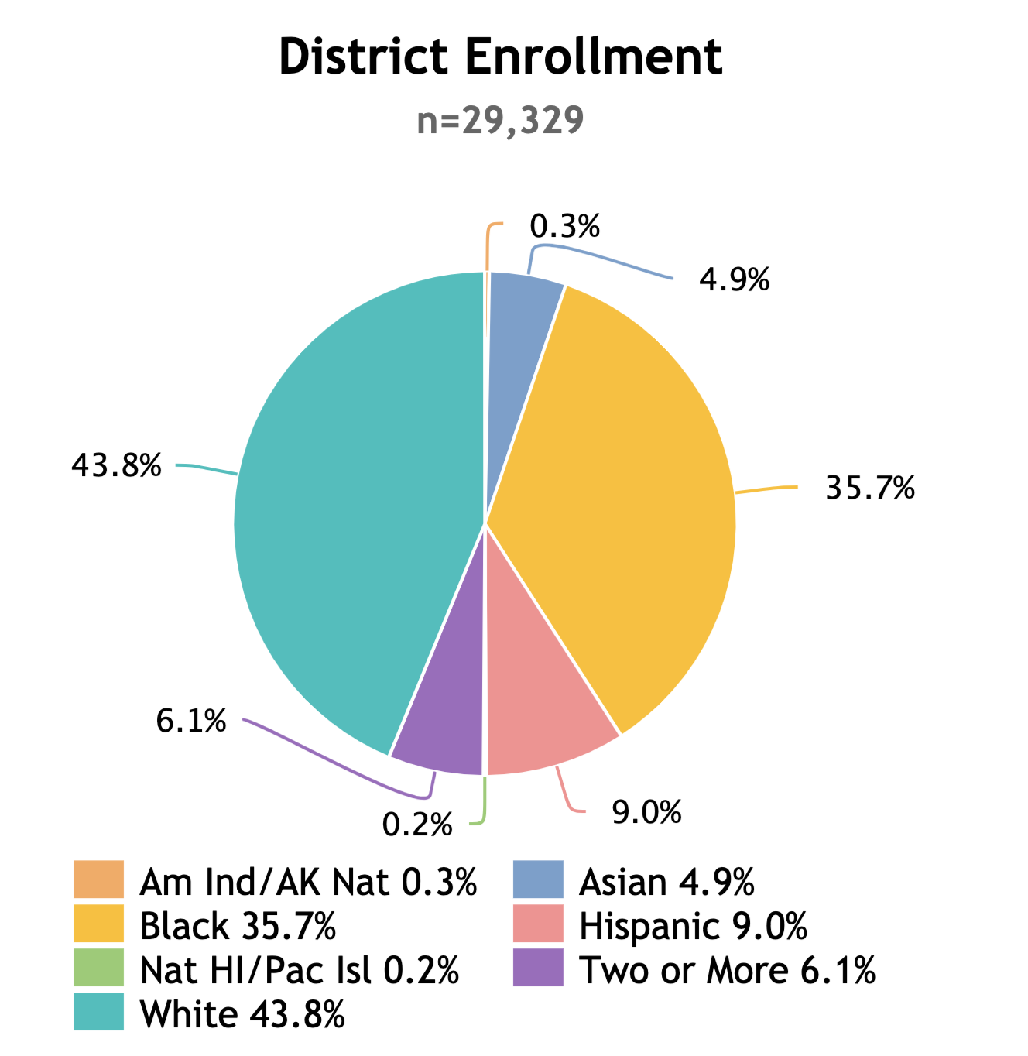
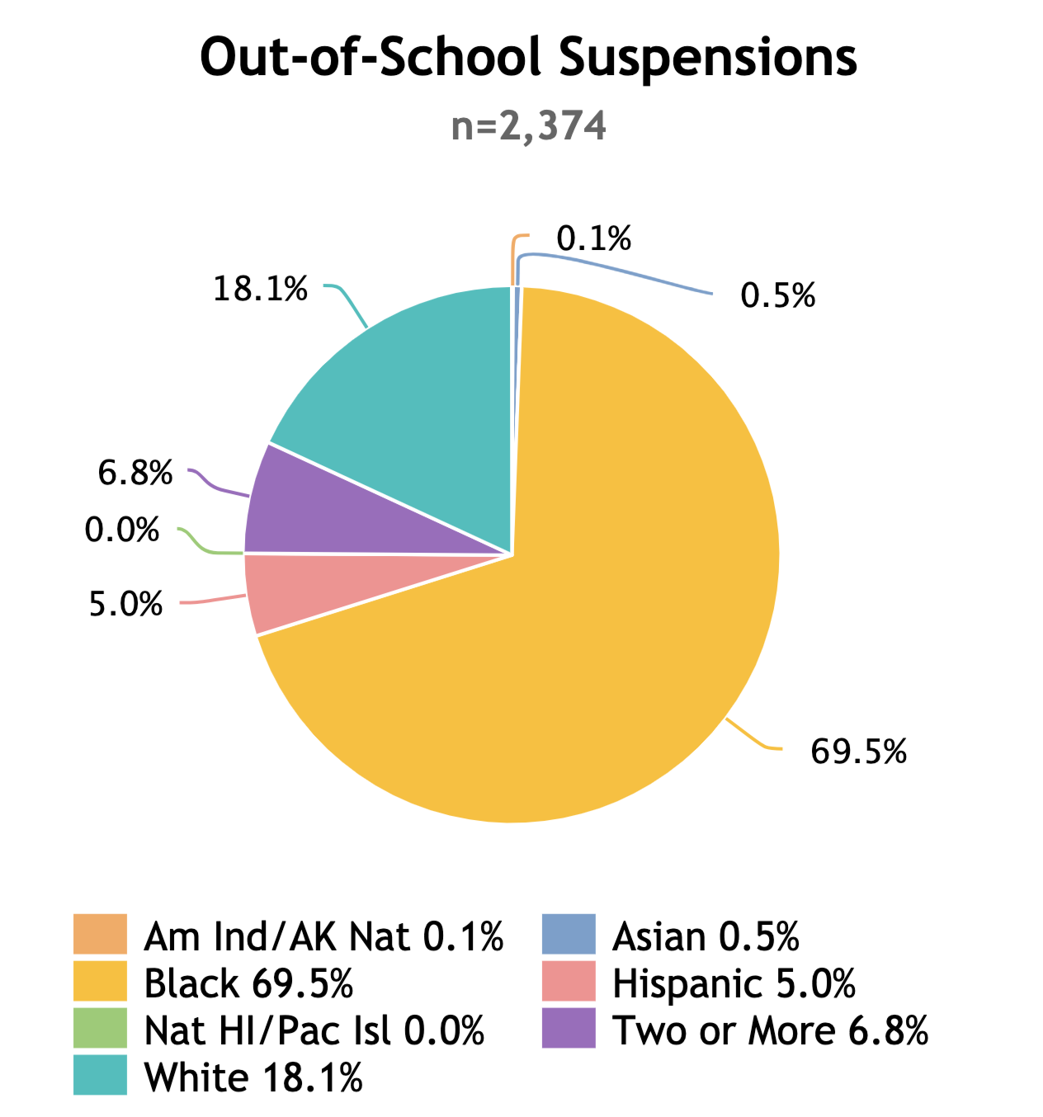
Survey year: 2015
Source: ED.Gov Civil Rights Data Collection

Slide 49
2nd Quartile
Source: Florida Department of Education

Slide 50
2nd Quartile
Source: Florida Department of Education

Slide 51
Source: Florida Department of Education

Slide 52
All children can learn what they need to be successful.
Data Development Agenda
Kindergarten Readiness by Race
Social skill measure for elementary, middle, and high school children
Post graduation outcomes (College, Vocational Program, Employment, Military Service)
Community wide (including private schools) risk and resilience survey, Florida Tobacco Survey, Florida Substance Abuse Survey

Slide 53
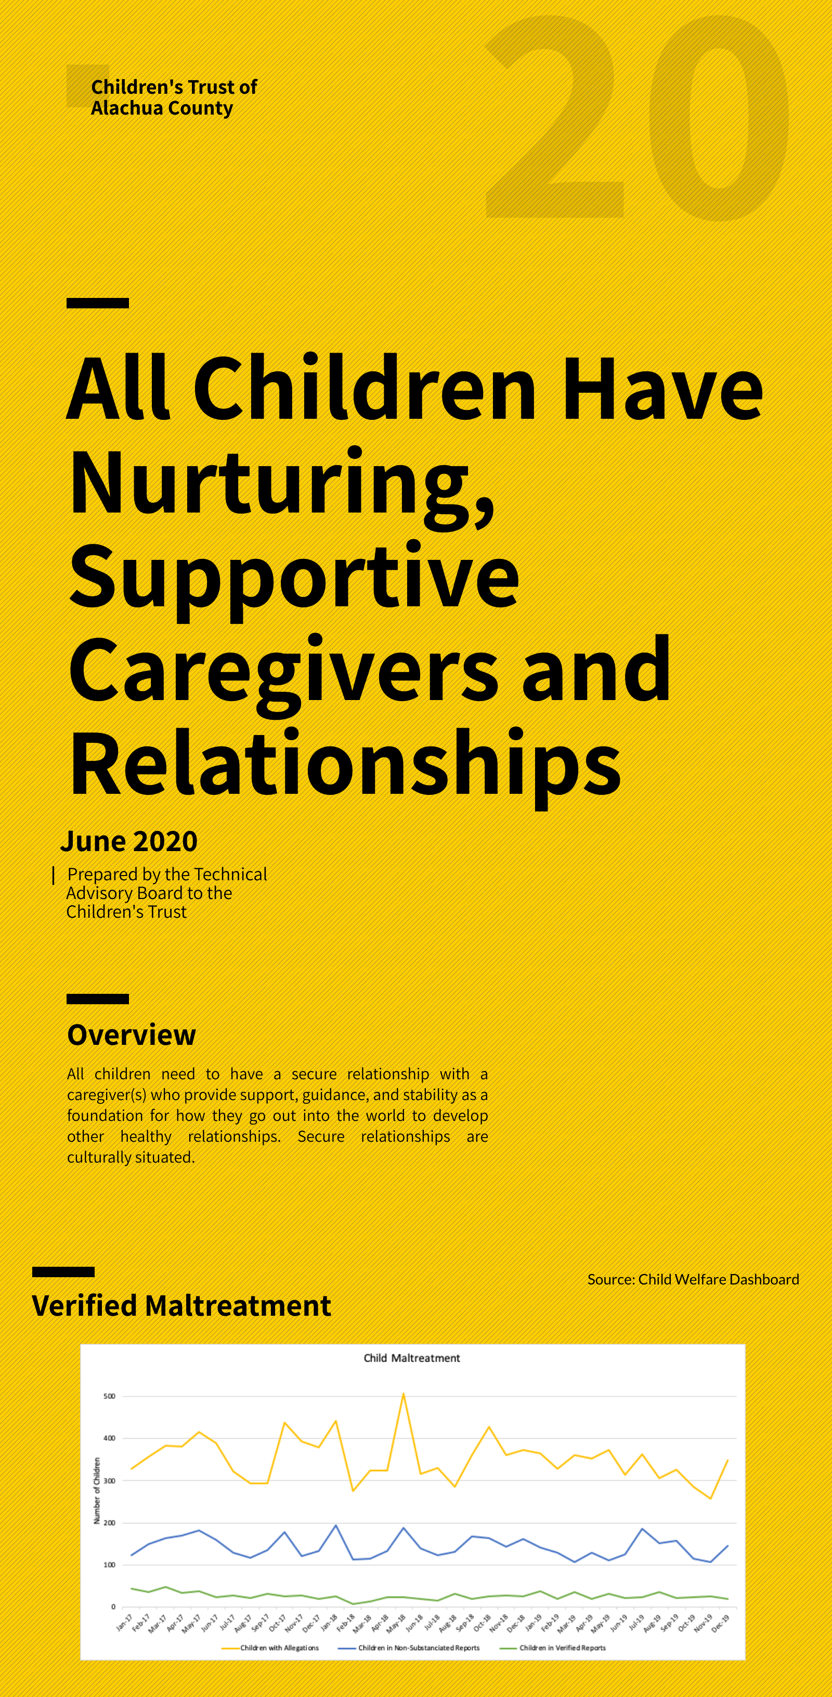
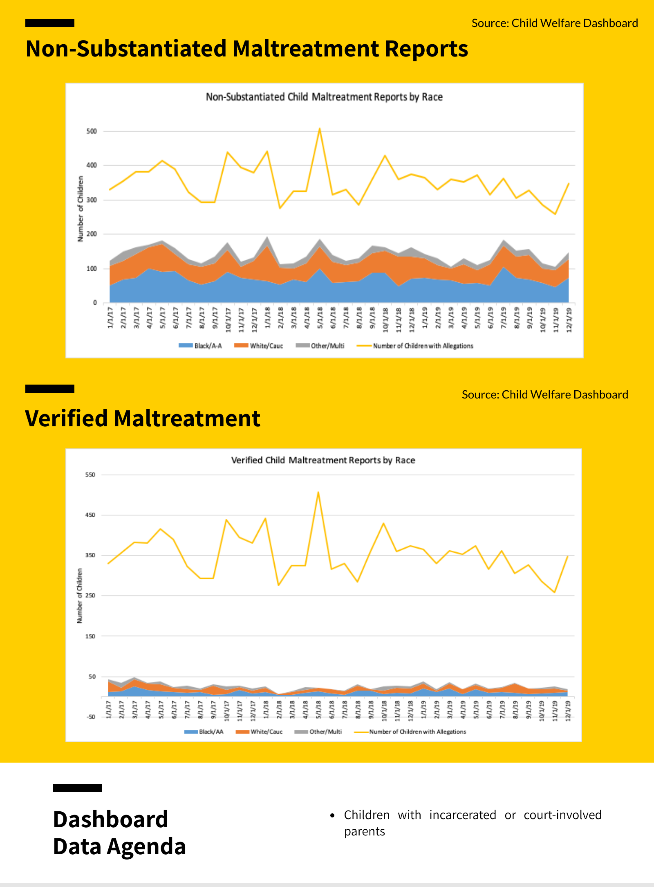
Access Here
8% Alachua County’s children DCF involvement

Slide 54
All children have nurturing, supportive caregivers and relationships.
Indicators
Child Welfare System
  Children in foster care*
  Children experiencing maltreatment (alleged, non-substantiated, verified)
Births to mothers without High School degree, 19 or older

Slide 55
Source: Child Welfare Dashboard

Slide 56
Source: Child Welfare Dashboard

Slide 57
Source: Child Welfare Dashboard

Slide 58
Source: Child Welfare Dashboard

Slide 59
Source: Child Welfare Dashboard

Slide 60
2nd Quartile
Source: FL Health Charts

Slide 61
Source: FL Health Charts

Slide 62
Source: FL Health Charts

Slide 63
All children have nurturing, supportive caregivers and relationships.
Data Development Agenda
Children moving from in-home to out-of-home care
Youth with incarcerated or court-involved parents
Children referred for behavioral problems or significant emotional distress

Slide 64

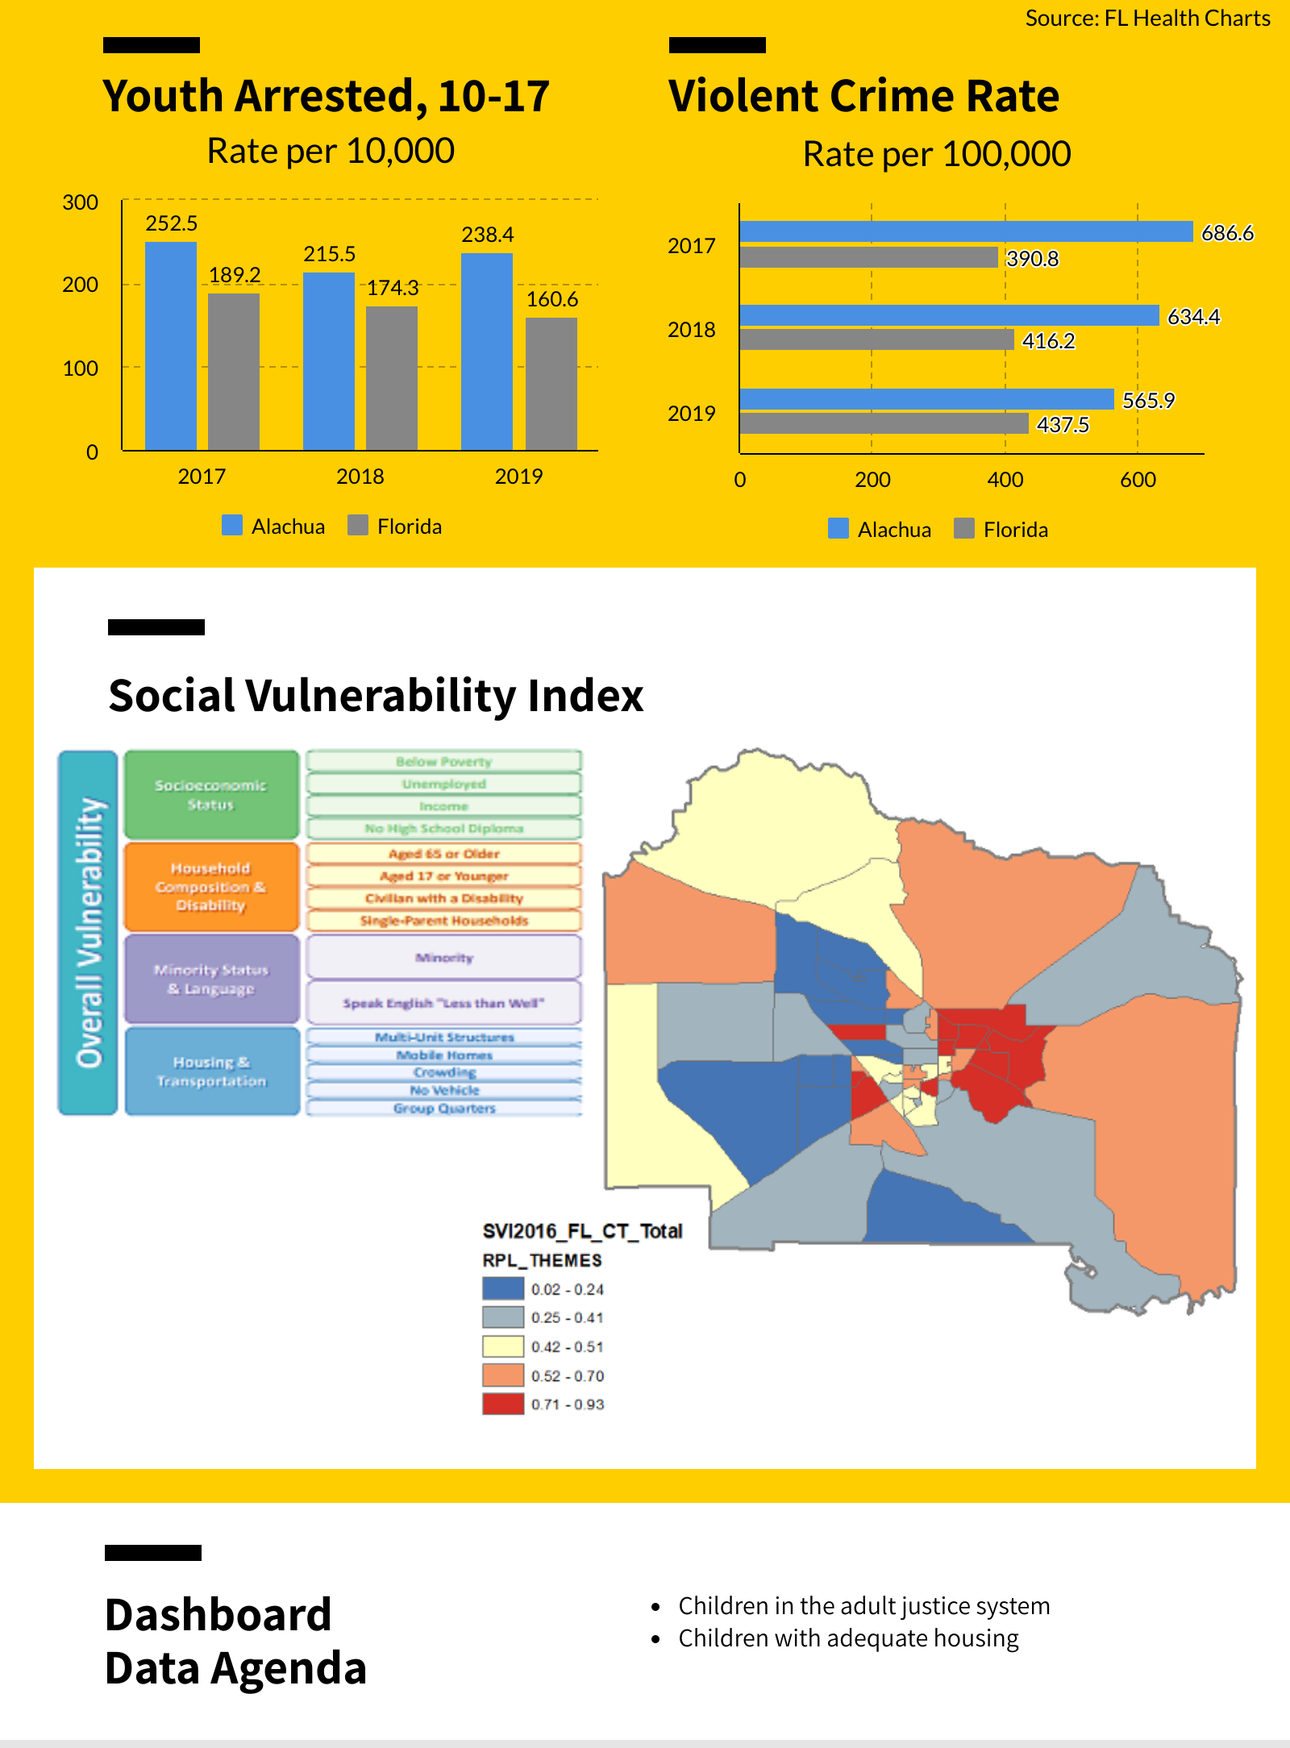
Access Here

Slide 65
All children live in a safe community.
Indicators
Youth arrested age 10-17*
Index crimes
Violent crime rate*
Children with adequate housing*
Social Vulnerability Index
  Socio-economic Status*
  Household composition & disability
  Minority status & language*
  Housing & transportation

Slide 66
4th Quartile
Source: FL Health Charts

Slide 67
Source: FL Health Charts

Slide 68
4th Quartile
Source: FL Health Charts

Slide 69
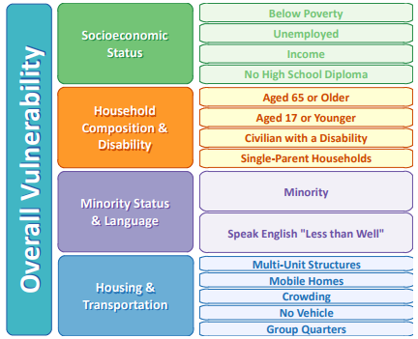
Agency for Toxic Substances & Disease Registry
CDC's Social Vulnerability Index (SVI)
What is the SVI?
Social vulnerability refers to the resilience of communities when confronted by external stresses on human health, stresses such as natural or human-caused disasters, or disease outbreaks. Reducing social vulnerability can decrease both human suffering and economic loss. CDC's Social Vulnerability Index uses 15 U.S. census variables at tract level to help local officials identify communities that may need support in preparing for hazards; or recovering from disaster. The Geospatial Research, Analysis, and Services Program (GRASP) created and maintains CDC’s Social Vulnerability Index.

Slide 70
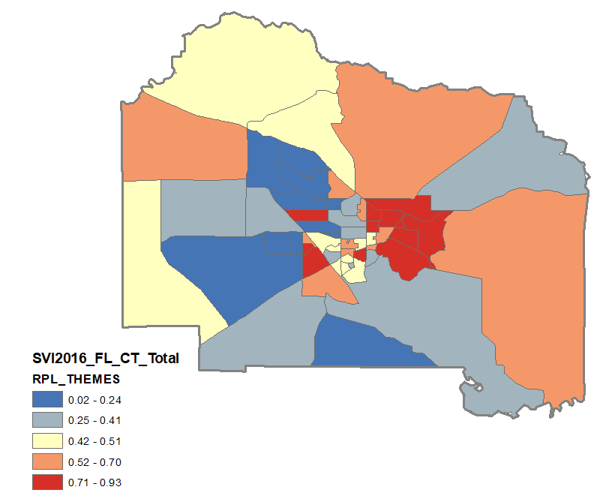
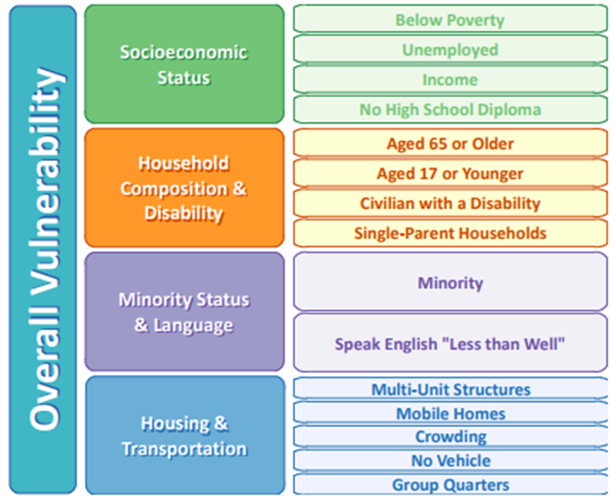

Slide 71
All children live in a safe community.
Data Development Agenda
Number of children in the adult justice system
Children eligible for citation who were arrested
Children arrested referred to a diversion program
Terry stops/walk and talks
  Children stopped by police under “reasonable suspicion”

Slide 72
Insights
In Alachua County there are significant racial disparities in ALL result areas due to both programmatic and structural barriers.
While the percentage of children with health insurance in Alachua County is higher than the state rate, several indicators of health show a need for closer examination (e.g. Infant deaths, Child Obesity, STDs) of the health status of children in Alachua County.
Access to quality early childhood experiences is an issue, particularly in East Alachua County. This is reflected in maps of access and kindergarten readiness rates. Florida sponsors VPK supports for 4-5 year old children, but supports for younger children are missing from our system.
Access to information about socially and academically beneficial programs for children ages 5-18 is limited. Rates of Youth Arrested, STDs among 13-20 aged teens, and continued educational disparities highlight a need for further investigation, supports, and programming.
Everything that we think we know about systems of support will be challenged due to current public health crisis.

Slide 73
Next Steps
Children’s Trust of Alachua County to determine priority results and key indicators as they relate to Technical Advisory Committee Insights.
CTAC to commission a focused strengths and needs assessment to discover the story behind the data. Strengths and needs assessment should include:
  Appraisal of what is currently known about the result
  Community strength finding
  Community need finding
  Resource and network mapping
  Discovering unmet needs
  Recommendations & Guidance

