Slide 1


Youth Development Capacity Building Plan
Bidder’s Conference
November 10, 2021

Slide 2
Meeting Technical Details
This information session is being recorded; the recording and PowerPoint will be available afterward.
Have a question?
Ask in the chat or unmute yourself

Slide 3
Meeting Agenda
Welcome and The Children’s Trust of Alachua County Overview
Background
Funding Overview
  ITN Purpose and Goals
  Minimum requirements to bid
  Terms of Service
  Solicitation Timeline
Scope of Services
  Budget
  Project Timeline
Evaluation Criteria
Review Process
Question and Answer Process
How to Apply

Slide 4
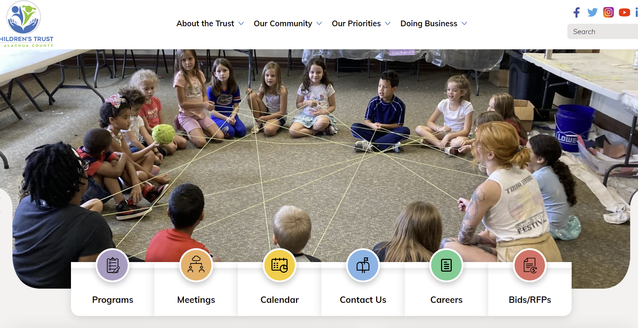
Welcome and The Children’s Trust of Alachua County Overview
https://www.childrenstrustofalachuacounty.us/
Notes:
Kristy – intro, quick website demo, review mission/vision/guiding principles/, how to access ITN information on website

Slide 5
Background of Youth Development Collaborative
In September 2021, The Children’s Trust of Alachua County (CTAC) announced the start of the Youth Development Capacity Building Collaborative and opened applications to any eligible out-of-school time (OST) providers serving children in K to 12th in Alachua County to participate in the collaborative.
The goal of the collaborative is to enhance OST provider’s organizational capacity and strengthen the OST system across Alachua County by:
Providing access to free training in key areas to improve organizational capacity
Supporting providers with capacity building funding and implementation support
Covening OST providers around best practices and coordination of services

Slide 6
Background of Youth Development Collaborative
Overall, 47 organizations signed up for the collaborative.
In order to participate in the collaborative, organizations had to meet the following requirements:
A. Applicant must be currently qualified to conduct business in the State of Florida.
B. Applicant must not be an Alachua County Public school or charter school approved by any public school system in the State of Florida.
C. Applicant must have experience working with youth in out-of school time and focus on promoting positive youth development in a safe and enriching environment.
D. Applicant must plan to offer in person OST services for after school 2021-2022 and/or Summer 2022 for children in grades K to 12th living in Alachua County

Slide 7
Background of Youth Development Collaborative
In October of 2021, CTAC hosted free training for collaborative members. The training intent was to equip providers with the foundational knowledge needed to develop and implement a capacity building plan. These trainings include:
● October 13th - Youth Development Collaborative Overview and Doing Business with the Trust (Not Required, Recommended)
● October 18th - Florida Afterschool Network Training (Required for all)
● October 20th - Early Learning Coalition School Readiness (only required for providers serving elementary-age children)
● October 27th - DCF Licensing (only required for providers serving elementary-age children in afterschool and do not currently have DCF license or exemption)
● November 4th - Florida Afterschool Network Training Part 2
Attendance at trainings was mandatory to be eligible for the capacity building funding included in this ITN.

Slide 8

Funding
Overview

Slide 9
Funding Opportunity
By approval of Resolution 2022-1 on November 8th, 2021, The Children's Trust of Alachua County seeks qualified out-of-school time (OST) providers who are interested in improving their organizational capacity by funding the development and implementation of a capacity building plan. Eligible applicants will be awarded grants to implement approved capacity-building plans in 2022. The total funding available is $300,000 for approved direct and indirect costs incurred while implementing the capacity building plan between January 1, 2022 and August 31, 2022.
Notes:
Participants will be awarded contracts with anticipated service dates of November 1st, 2021, through Sept 30th, 2022.
An estimated $500,000 in funding will be available for capacity building plans.

Slide 10
What is an Invitation to Negotiate (ITN)?
An Invitation to Negotiate (ITN) is a written solicitation for competitive, sealed replies to select one or more applicants with which to commence negotiations. ITNs are used when CTAC determines negotiations may be necessary to receive the best value. Cost may or may not be a consideration when negotiating.

Slide 11
ITN Purpose & Goals
The purpose of this ITN is to support OST providers in the development and implementation of a capacity building plan that focuses on increasing:
1) program access
2) program quality, and/or
3) organizational readiness for future CTAC funding.
Utilizing the standards for quality OST programs provided by the Florida Afterschool Network, providers will complete a capacity building plan. The Florida Standards for Quality Afterschool Programs define the core principles and best practices that lead to the delivery of quality programming for children and youth in OST settings. The standards provide a framework for the development of a caring, dynamic, stimulating, and safe OST environment for children and youth.
Notes:
Participants will be awarded contracts with anticipated service dates of November 1st, 2021, through Sept 30th, 2022.
An estimated $500,000 in funding will be available for capacity building plans.

Slide 12
ITN Purpose & Goals
Goal: By supporting OST providers’ efforts to improve program quality, CTAC seeks to expand access to safe and enriching OST programming for children from low-income families living in Alachua County by funding organizations that have a positive impact on children, youth and families to support a continuum of quality programming.
The intent of the capacity building plan is to support organizations ability to meet or exceed the following CTAC existing requirements for OST programming.
After School program minimum requirements:
● Implement programming that serves children with creative and enriching programming
● Programming is offered 4 days week, with at least 1.5 hours of programming per day throughout school year
● Programs employ highly qualified staff members capable of developing strong, positive relationships with youth participants.
● Sites are safe and enriching environments and have an active and/or exempt DCF license
● Each program has at least one staff member available onsite trained in first aid and infant and child cardiopulmonary resuscitation (CPR) procedures
● Minimum staff ratios are 1:20 and all staff have Level 2 background screenings.
● Programs have an assigned program director responsible to managing and implementing programs and coordinating with CTAC staff
● Serve low-income children that reside in Alachua County
Notes:
Participants will be awarded contracts with anticipated service dates of Januaryr 1st, 2021, through Sept 30th, 2022.
An estimated $300,000 in funding will be available for capacity building plans.

Slide 13
ITN Purpose & Goals
Goal: By supporting OST providers’ efforts to improve program quality, CTAC seeks to expand access to safe and enriching OST programming for children from low-income families living in Alachua County by funding organizations that have a positive impact on children, youth and families to support a continuum of quality programming.
The intent of the capacity building plan is to support organizations ability to meet or exceed the following CTAC existing requirements for OST programming.
Summer program minimum requirements:
● Implement programming that serves children with creative and enriching programming
● Programming is offered to meet the needs of children and parents during summer months
● Programs employ highly qualified staff members capable of developing strong, positive relationships with youth participants.
● Sites are safe and enriching environments
● Each program has at least one staff member available onsite trained in first aid and infant and child cardiopulmonary resuscitation (CPR) procedures
● Minimum staff ratios are 1:20 and all staff have Level 2 background screenings
● Serve low-income children that reside in Alachua County
Notes:
Participants will be awarded contracts with anticipated service dates of November 1st, 2021, through Sept 30th, 2022.
An estimated $500,000 in funding will be available for capacity building plans.

Slide 14
Minimum Requirements to Bid
Eligible organizations can apply for funding based on the following requirements:
Provider must be currently qualified to conduct business in the State of Florida
Provider must not be an Alachua County Public school or charter school approved by any public school system in the State of Florida
Provider must have applied and been accepted in the Youth Development Capacity Building Collaborative in October 2021
Provider must have completed baseline survey included in welcome email
Provider must have completed training requirements
○ October 13th - Youth Development Collaborative Overview and Doing Business with the Trust (Not required but recommended)
○ October 18th - Florida Afterschool Network Training (Required for all)
○ October 20th - Early Learning Coalition School Readiness (only required for providers serving elementary-age children)
○ October 27th - DCF Licensing (only required for providers serving elementary-age children in afterschool and do not currently have DCF license or exemption)
○ November 4th - Florida Afterschool Network Training Part 2 (Not required but recommended)
Notes:
Participants will be awarded contracts with anticipated service dates of November 1st, 2021, through Sept 30th, 2022.
An estimated $500,000 in funding will be available for capacity building plans.

Slide 15
Minimum Requirements to Bid
Provider must have offered a summer program in 2019, 2020, or 2021 and/or Provider must have offered an afterschool program in 2019-20, 2020-21 or current afterschool program in 2021-22.
Provider must meet the following definition for OST programs:
A) Implement creative, innovative, programming that meet the needs and interests of children enrolled in their programming, including academic programs (e.g. reading or math focused programs), specialty programs (e.g. sports teams, STEM, arts enrichment) and multipurpose programs that provide an array of activities.
B) Operate in a physical environment that adequately and safely accommodates all program activities
C) Offer OST ongoing in person services and programming for afterschool and/or summer
D) Employ highly qualified staff members capable of developing strong, positive relationships with youth participants and are committed to professional development
E) Serve children between the grades of kindergarten through 12th grade
F) Serve the same children on an ongoing basis (typically multiple days per week)
G) Provider is responsible for supervision of children while providing services
H) Not primarily serve children on a one-on-one basis
I) Not be an enhancement provider that primarily provides push-in/add-in services to another program
Notes:
Participants will be awarded contracts with anticipated service dates of November 1st, 2021, through Sept 30th, 2022.
An estimated $500,000 in funding will be available for capacity building plans.

Slide 16
Terms of Service
Successful applicants will be awarded grants to implement approved capacity-building plans in 2022.
The total funding available is $300,000 for approved direct and indirect costs incurred while implementing the capacity building plan between January 1, 2022 and August 31, 2022.
Submission of a capacity building plan does not guarantee funding.
Successful applicants will be fee for service contracts based on deliverables established in their capacity building plans.
Notes:
Participants will be awarded contracts with anticipated service dates of November 1st, 2021, through Sept 30th, 2022.
An estimated $500,000 in funding will be available for capacity building plans.

Slide 17
Solicitation Timeline
EVENT | DATE/DUE DATE
Release of the competitive solicitation and the beginning of the Cone of Silence | Tuesday, November 9, 2021
Optional Bidders Conference Attendance is highly recommended | Wednesday, November 10, 2021, 10AM EST
Last day to submit written questions | Tuesday, November 16, 2021 @ 2:00 PM EST
Final response to all written questions posted | Thursday, November 18, 2021
Submission Deadline | Friday, November 19th, 2021 @ 6:00PM
Application Review Period | November 20th – November 30th 2021
Applicant interviews (upon discretion of the CTAC) | December 1st -3rd 2021
Public Evaluation of Applications Zoom registration link: (TBD) | Friday, December 3rd, 2021, 4PM
Funding recommendations released; end of the cone of silence | Monday, December 6th, 2021
The Children’s Trust of Alachua County Board Meeting - Review of Award Recommendation | Monday, December 13th, 2021
Appeal review starts (if needed) | Tuesday, December 14th, 2021
Contract Negotiations begin | Wednesday, December 15th, 2021
Notes:
Participants will be awarded contracts with anticipated service dates of November 1st, 2021, through Sept 30th, 2022.
An estimated $500,000 in funding will be available for capacity building plans.

Slide 18
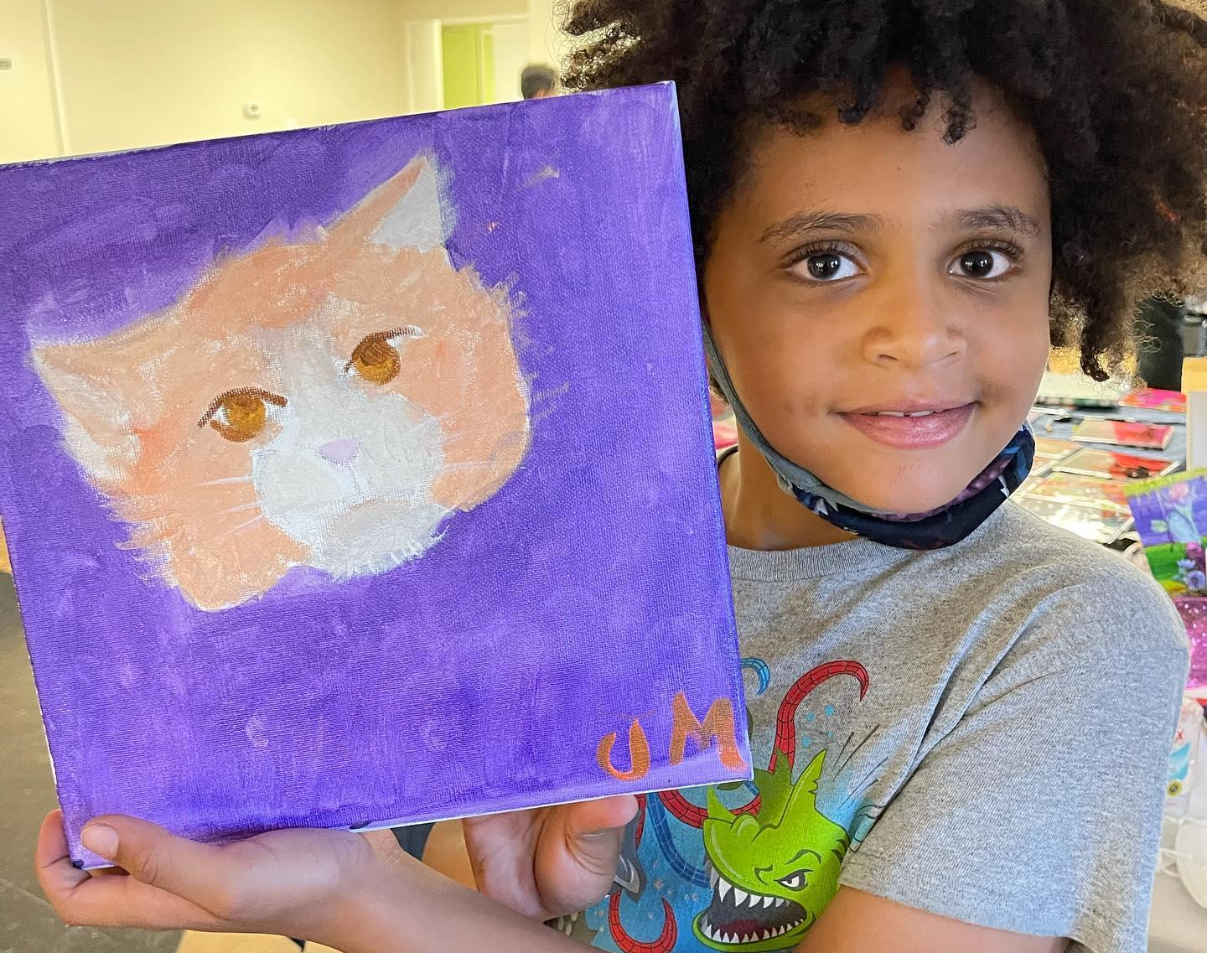
Capacity Building Plan

Slide 19
Scope of Services
Organizations are expected to build their organizational capacity to meet or exceed the existing CTAC afterschool and/or summer minimum programming requirements. The capacity building plan includes the following categories:
1. Administration and Organization
2. Program Management and Staff
3. Communication and Interaction
4. Program Structure and Activities
Providers will complete a self-assessment of their current organizational capacity and identify and prioritize between 5 to 10 standards to focus their capacity building goals and deliverables. Each selected element will include a program goal that will follow a SMART goal format:
Specific (simple, sensible, significant)
Measurable (meaningful, motivating)
Achievable (agreed, attainable)
Relevant (reasonable, realistic and resourced, results-based)
Time bound (time-based, time limited, time/cost limited, timely, time-sensitive)
5. Health, Safety and Nutrition
6. Program Environment
7. Family and Community Involvement
8. System Building

Slide 20
Budget
Providers will be awarded capacity building funding to support the successful completion of their plans. Program budget will include the following categories
Indirect Planning: Programs will be awarded 20% of their verified OST program revenues in the previous year to support capacity building program planning. If the program OST budget is over $150,000, indirect planning funding will be capped at $30,000. If the program OST budget is under $25,000, indirect planning funding will be $5,000. Providers will be compensated upon completion of deliverables identified on their capacity building plans. Each goal identified on the capacity building plan will be assigned a funding value at time of contracting based on the number of goals included in the plan.
Direct Costs: Programs will be awarded direct costs to support the implementation of specific activities associated with obtaining DCF Licensing and/or Background Screenings. CTAC will pay for all reasonable costs, but they must be estimated at time of contracting and approved in advance by contract manager. Providers will be compensated for direct costs on a cost-reimbursement basis with appropriate documentation. Providers can receive an initial advance of 25% of direct costs but reimbursements must be trued up before additional payments are made. Payments in excess of the trued up value will need to be returned to the CTAC at the conclusion of the contract.
Notes:
Participants will be awarded contracts with anticipated service dates of November 1st, 2021, through Sept 30th, 2022.
An estimated $500,000 in funding will be available for capacity building plans.

Slide 21
Budget
Eligible Funding Uses
● Funding can be used for eligible expenses, as defined below. Expenses must be incurred between Jan 1, 2022 - August 31, 2022.
● Direct costs for tasks and activities related to DCF Licensing, and Background Screenings.
● To purchase supplies and materials needed to improve safety and wellness or program activities.
● To account for staff time spent planning, developing and completing strategies.
● Software and technology items that do not individually cost over $1,000 (see funding restrictions)
Funding Restrictions
● Grant funding cannot be used for the following purposes:
● The purchase of capital equipment. Capital equipment represents individual items purchased at a cost of $1,000 or more with a life expectancy of more than a year.
● Revenue replacement or revenue losses experienced during the contract period
● Duplicative expenses already covered in the known grants or contracts
● Real property

Slide 22
Program Timeline
DATE RANGE | DELIVERABLE | EVIDENCE | DUE DATE
Date of Award – January 1st, 2022 | 1. Approved Capacity Building Plan and self-assessments | □ Approved Capacity Building Plan | January 10th, 2022
January 2022 – August 2022 | 2. Attend monthly provider meetings | □ Training attendance | TBD
February 2022 - August 2022 | 3. Monthly Progress Reports and invoices | □ Monthly Progress Reports | Due of the 1st Monday of every month
August 31st, 2022 | 4. End-of-Program Narrative and Post self-assessments | □ End-of-Program Narrative □ Self-assessments | August 31st, 2022
Notes:
need to work on this

Slide 23
Evaluation Criteria
Each application will be evaluated against the following criteria:
Evaluation Criteria | Review Guidelines | Points Awarded
Organizational Eligibility | The applicant clearly meets all minimum Requirements to bid. | 1
Capacity Building Plan | The applicant submitted all forms and completed a satisfactory capacity building plan and budget. | 1
 | Total | 2 points
Applicants that meet the criteria will be recommended for funding
Application Score | Funding Recommendations
2 | Green – Recommended for Funding
1 or less | Red – Not Recommended for Funding

Slide 24
Review Process
Invitation to Negotiates (ITN) is released to prospective contractors.
To help ensure that all prospective contractors are treated consistently during the selection process, all questions regarding this ITN, as well as CTAC’s responses to the questions will be posted on CTAC’s website. The deadline for the receipt of written questions is Thursday, November 18, 2021
All proposals must be received by CTAC no later than Friday, November 19th, 2021 @ 6:00PM. Late proposals will not be accepted and will not be reviewed.
Proposals are independently reviewed and scored by a team of reviewers that may include Trust staff, experts in the field and trained volunteers. Using the evaluation criteria, reviewers assess the soundness and completeness of each proposal as well as the vendor’s capacity to effectively deliver what is proposed.
At the CTAC's discretion, publicly noticed interviews and/or site visits may be conducted at either the vendor's site or the CTAC's offices. Members of the public may attend interviews and/or site visits as observers. The interview/site visit review team may include Trust staff, experts in the field and trained volunteers. The purpose of the interview/site visit is to confirm the applicant meets all minimum requirements to bid and to negotiate terms of the proposed capacity building plan, including funding amounts.
Taking into consideration the above review process results, the Executive Director of the CTAC develops a recommendation which are reviewed and considered by the CTAC Board at a publicly noticed meeting. Applicants are encouraged to attend these meetings.
Any actual or prospective bidder or proposer, who is allegedly aggrieved in connection with the issuance of a bid or proposal package or pending award of a contract, may protest the decision.

Slide 25
Review Process
The CTAC reserves the right to:
● Reject any or all submittals
● Request clarification of any submitted information
● Waive any informalities or irregularities in any response
● Not enter into any contract
● Not select any firm
● Cancel this process at any time
● Amend this process at any time
● Interview firms prior to award
● Enter into negotiations with one or more firms, or request a best and final offer (BAFO)
● Award more than one contract if it is in the best interests of the CTAC
● Issue similar solicitations in the future
● Request additional information from prospective contractors

Slide 26
Negotiation Process
CTAC staff members will meet with organizations to negotiate their capacity building plans. This could mean:
  Revising goals and deliverables
  Selecting more challenging standards to accomplish
  Negotiating estimated costs and funding amounts
CTAC staff may conduct interview/site visit is to confirm the applicant meets all minimum requirements to bid and to negotiate terms of the proposed capacity building plan, including funding amounts.

Slide 27
Question and Answer Process
All questions must be submitted online via this link: https://www.childrenstrustofalachuacounty.us/programs/webform/itn-2022-01-question-submission-youth-development-capacity-building-itn
Answers will be posted on the website under the ITN opportunity

Slide 28
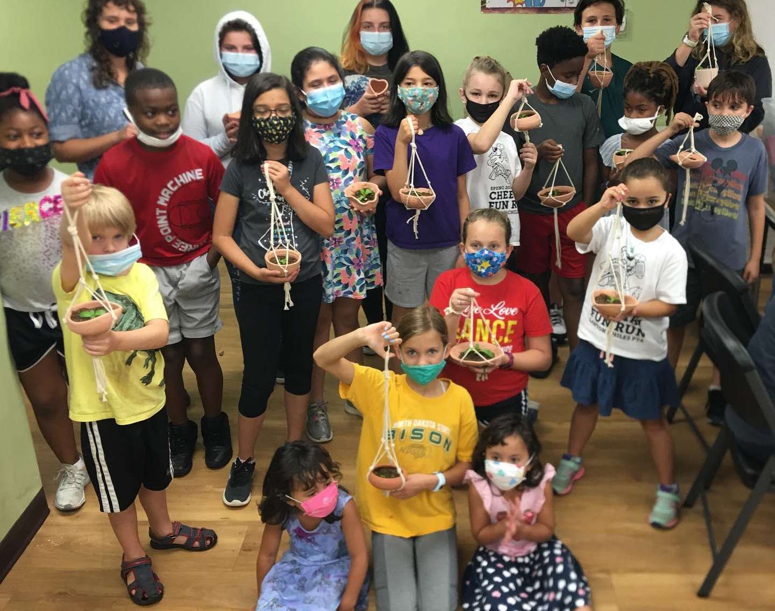
Application Process

Slide 29
How to Apply
The response to this ITN shall consist of:
A completed FORM 1 - Prospective Contractor Certification (included in this solicitation).
A completed FORM 2 - Organizational Information (included in this solicitation).
A completed FORM 3 - Capacity Building Self-Assessment Tool (included in this solicitation).
A completed FORM 4 - Capacity Building Plan and Budget (included in this solicitation).
Additional Documents Required for Submission
  Proof of Corporate Status and Legal Address (note: from SunBiz)
  Proof of OST program revenue from most recent fiscal year (such as tax documents IRS 990, audited financial statements, balance sheets, Philanthropy hub profiles etc.)
  Copy of IRS 501(c)(3) Determination Letter (if applicable)
All completed application shall be submitted via email Procurement@childrenstrustofalachuacounty.us by deadline. Emails should include the following details:
Subject Line: [Organization Name] – Youth Development Capacity Building Collaborative
PDF attachments above forms must be included in a single email to be considered completed. Please clearly label all application materials with form name and organization.

Slide 30
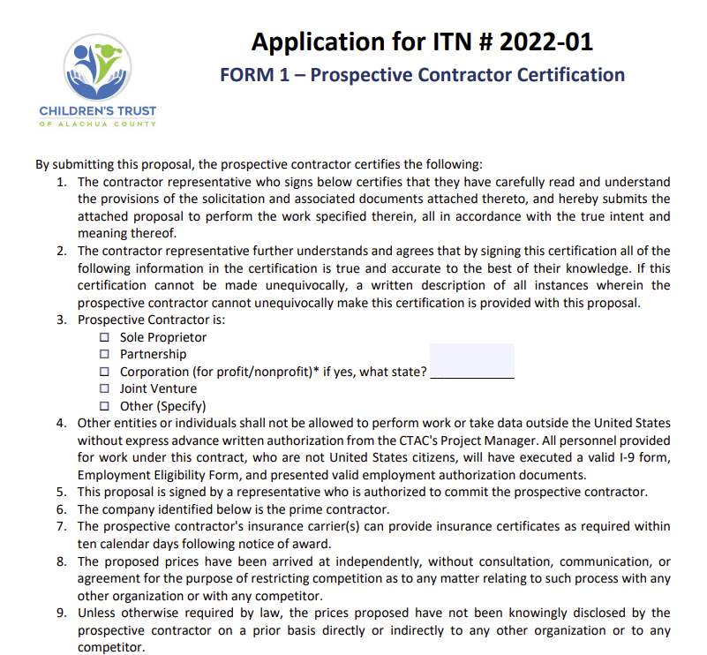
FORM 1 – Prospective Contractor Certification

Slide 31
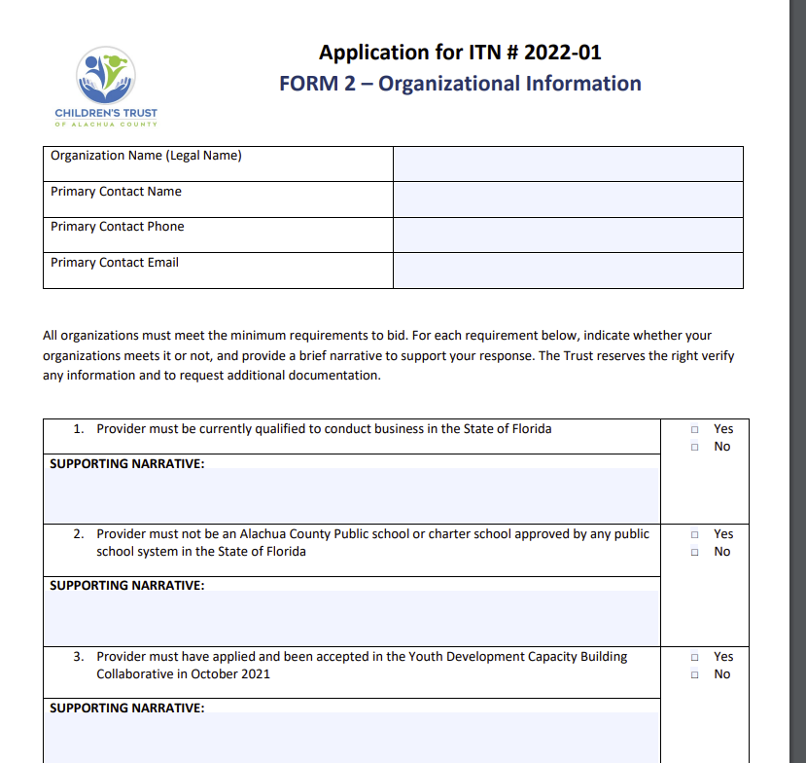
FORM 2 – Organizational Information

Slide 32
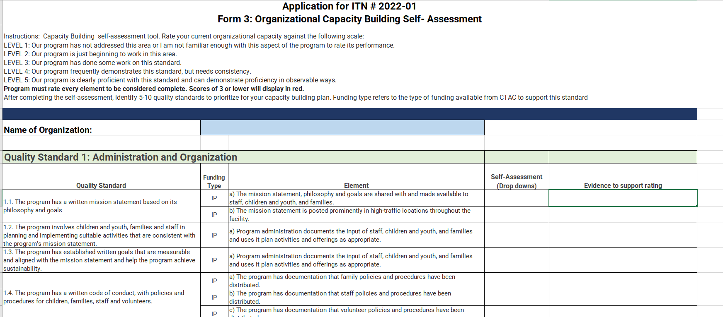
FORM 3 – Organizational Capacity Self-Assessment

Slide 33
Completing the Capacity Building Self- Assessment
In this form, you will rate your current organizational capacity against the following scale:
LEVEL 1: Our program has not addressed this area or I am not familiar enough with this aspect of the program to rate its performance.
LEVEL 2: Our program is just beginning to work in this area.
LEVEL 3: Our program has done some work on this standard.
LEVEL 4: Our program frequently demonstrates this standard, but needs consistency.
LEVEL 5: Our program is clearly proficient with this standard and can demonstrate proficiency in observable ways.
Program must rate every element and provide a justification for their rating to be considered complete.
Scores of 3 or lower will display in red.

Slide 34
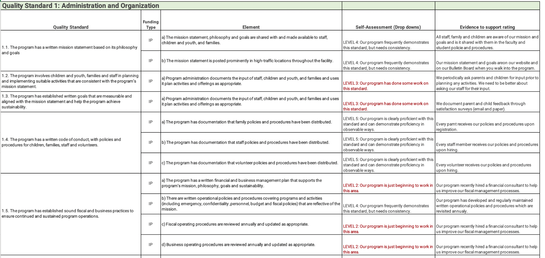
Completing the Capacity Building Self- Assessment

Slide 35
Identifying and Prioritizing Areas of Improvement
After completing the self-assessment, identify 5-10 quality standards that you scored a Level 3 or lower to prioritize for your capacity building plan.
Remember:
CTAC staff will directly support you in achieving the full scope of your action plan
CTAC recommends you focus on areas of your organization where you scored a 3 or lower AND supports your program's ability to meet or exceed the minimum requirements for afterschool and/or summer programming.
You will receive funding to support the implementation of your action plan. Choose quality standards that justify the funding amount allocated.

Slide 36

Identifying and Prioritizing Areas of Improvement

Slide 37
SMART Goals
Each selected element will include a program goal that will follow a SMART goal format:
Specific (simple, sensible, significant)
Consider who, what, when, where, which and why
Measurable (meaningful, motivating)
What metrics will you use to determine if you met the goal?
Achievable (agreed, attainable)
What do you need to do to make the goal attainable (skill development, change in attitudes)
Relevant (reasonable, realistic and resourced, results-based)
Does the goal align with your mission and vision?
Time bound (time-based, time limited, time/cost limited, timely, time-sensitive)
What is the target date you will accomplish your goal by

Slide 38
SMART Goal
Goal Statement: By March 2022, ABC Organization will identify what improvements are needed in order to obtain DCF licensing for all three of our sites that serve elementary school children. ABC Organization will work to implement these changes before June 2022, in preparation for Summer programming. By August 2022, all changes will be incorporated and DCF licensing will be obtained to provide quality programming to children in our program.
Specific: Includes what, when and where
Measurable: Includes milestones to measure progress
Achievable: By breaking up the goal into milestones, we make it more attainable
Relevant: Includes connection to broader mission
Time-Bound: Clear target dates for accomplishing goal

Slide 39
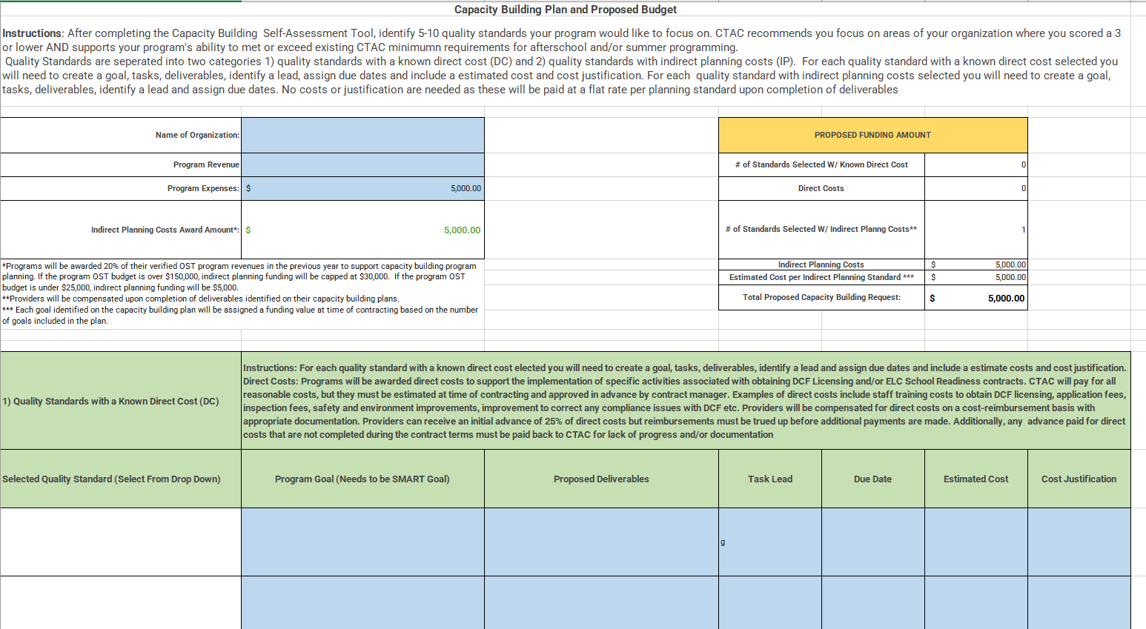
FORM 4 – Capacity Building Plan and Budget

Slide 40
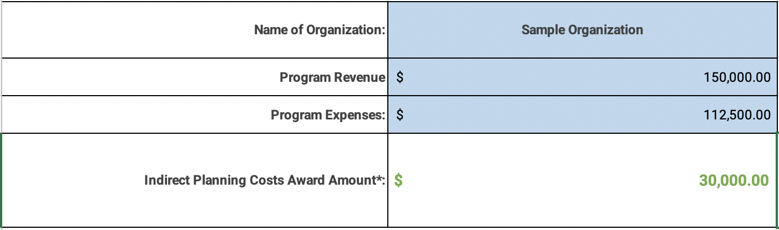
Program Budget
Enter your program revenue and expenses.
  Programs will be awarded 20% of their verified OST program revenues in the previous year to support capacity building program planning. If the program OST budget is over $150,000, indirect planning funding will be capped at $30,000. If the program OST budget is under $25,000, indirect planning funding will be $5,000.
  Providers will be compensated upon completion of deliverables identified on their capacity building plans.

Slide 41
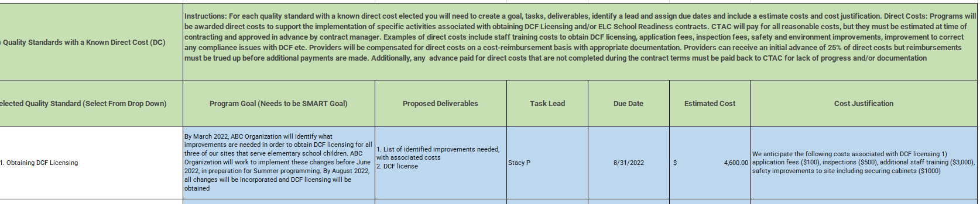
Quality Standards with a Known Direct Cost
Programs will be awarded direct costs to support the implementation of specific activities associated with obtaining DCF Licensing and/or ELC School Readiness contracts. CTAC will pay for all reasonable costs, but they must be estimated at time of contracting and approved in advance by contract manager.
Providers will be compensated for direct costs on a cost-reimbursement basis with appropriate documentation.
Providers can receive an initial advance of 25% of direct costs but reimbursements must be trued up before additional payments are made. Payments in excess of the trued-up value will need to be returned to the CTAC at the conclusion of the contract.

Slide 42
Quality Standards with Indirect Planning Costs
The estimated amount of indirect planning costs will calculate based on the number of elements selected. Each goal identified on the capacity building plan will be assigned a funding value at time of contracting based on the number of goals included in the plan.
It is important to keep this amount in mind as you are prioritizing elements and developing goals, tasks and timelines for your action plan.
Funding allocated to planning costs will be evenly split among the elements selected.
  For example, if you have $10,000 in planning costs and select 5 elements, you will have $2,000 allocated for each element.
Providers will be compensated upon completion of deliverables identified on their capacity building plans.

Slide 43
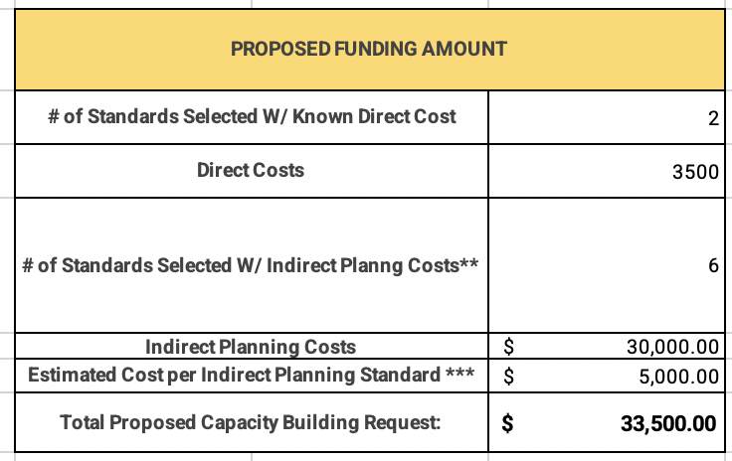
Completing the Capacity Building Plan
As you identify all of the standards for your capacity building plan and add in all required information for each standard, the proposed funding amount table will reflect your changes.

Slide 44
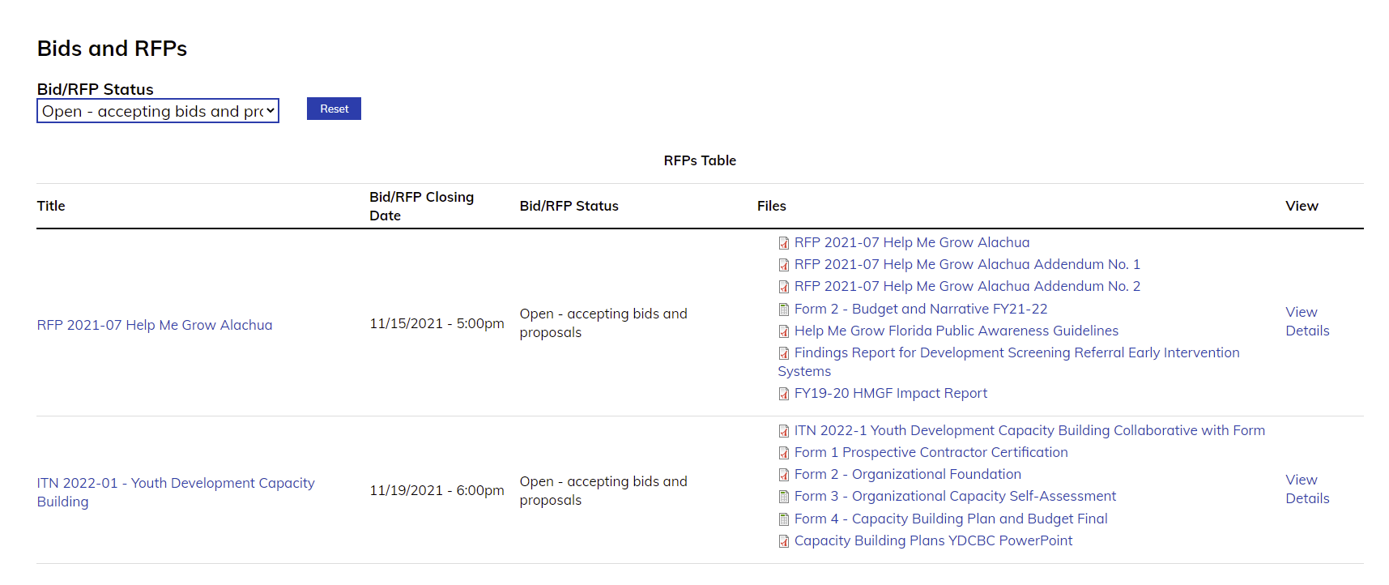
Apply to Today
https://www.childrenstrustofalachuacounty.us/programs/page/itn-2022-01-youth-development-capacity-building
Notes:
https://www.childrenstrustofalachuacounty.us/programs/page/itn-2022-01-youth-development-capacity-building

Slide 45
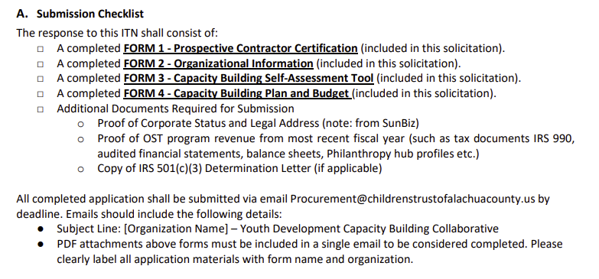
Apply to Today
https://www.childrenstrustofalachuacounty.us/programs/page/itn-2022-01-youth-development-capacity-building
Notes:
https://www.childrenstrustofalachuacounty.us/programs/page/itn-2022-01-youth-development-capacity-building

Slide 46
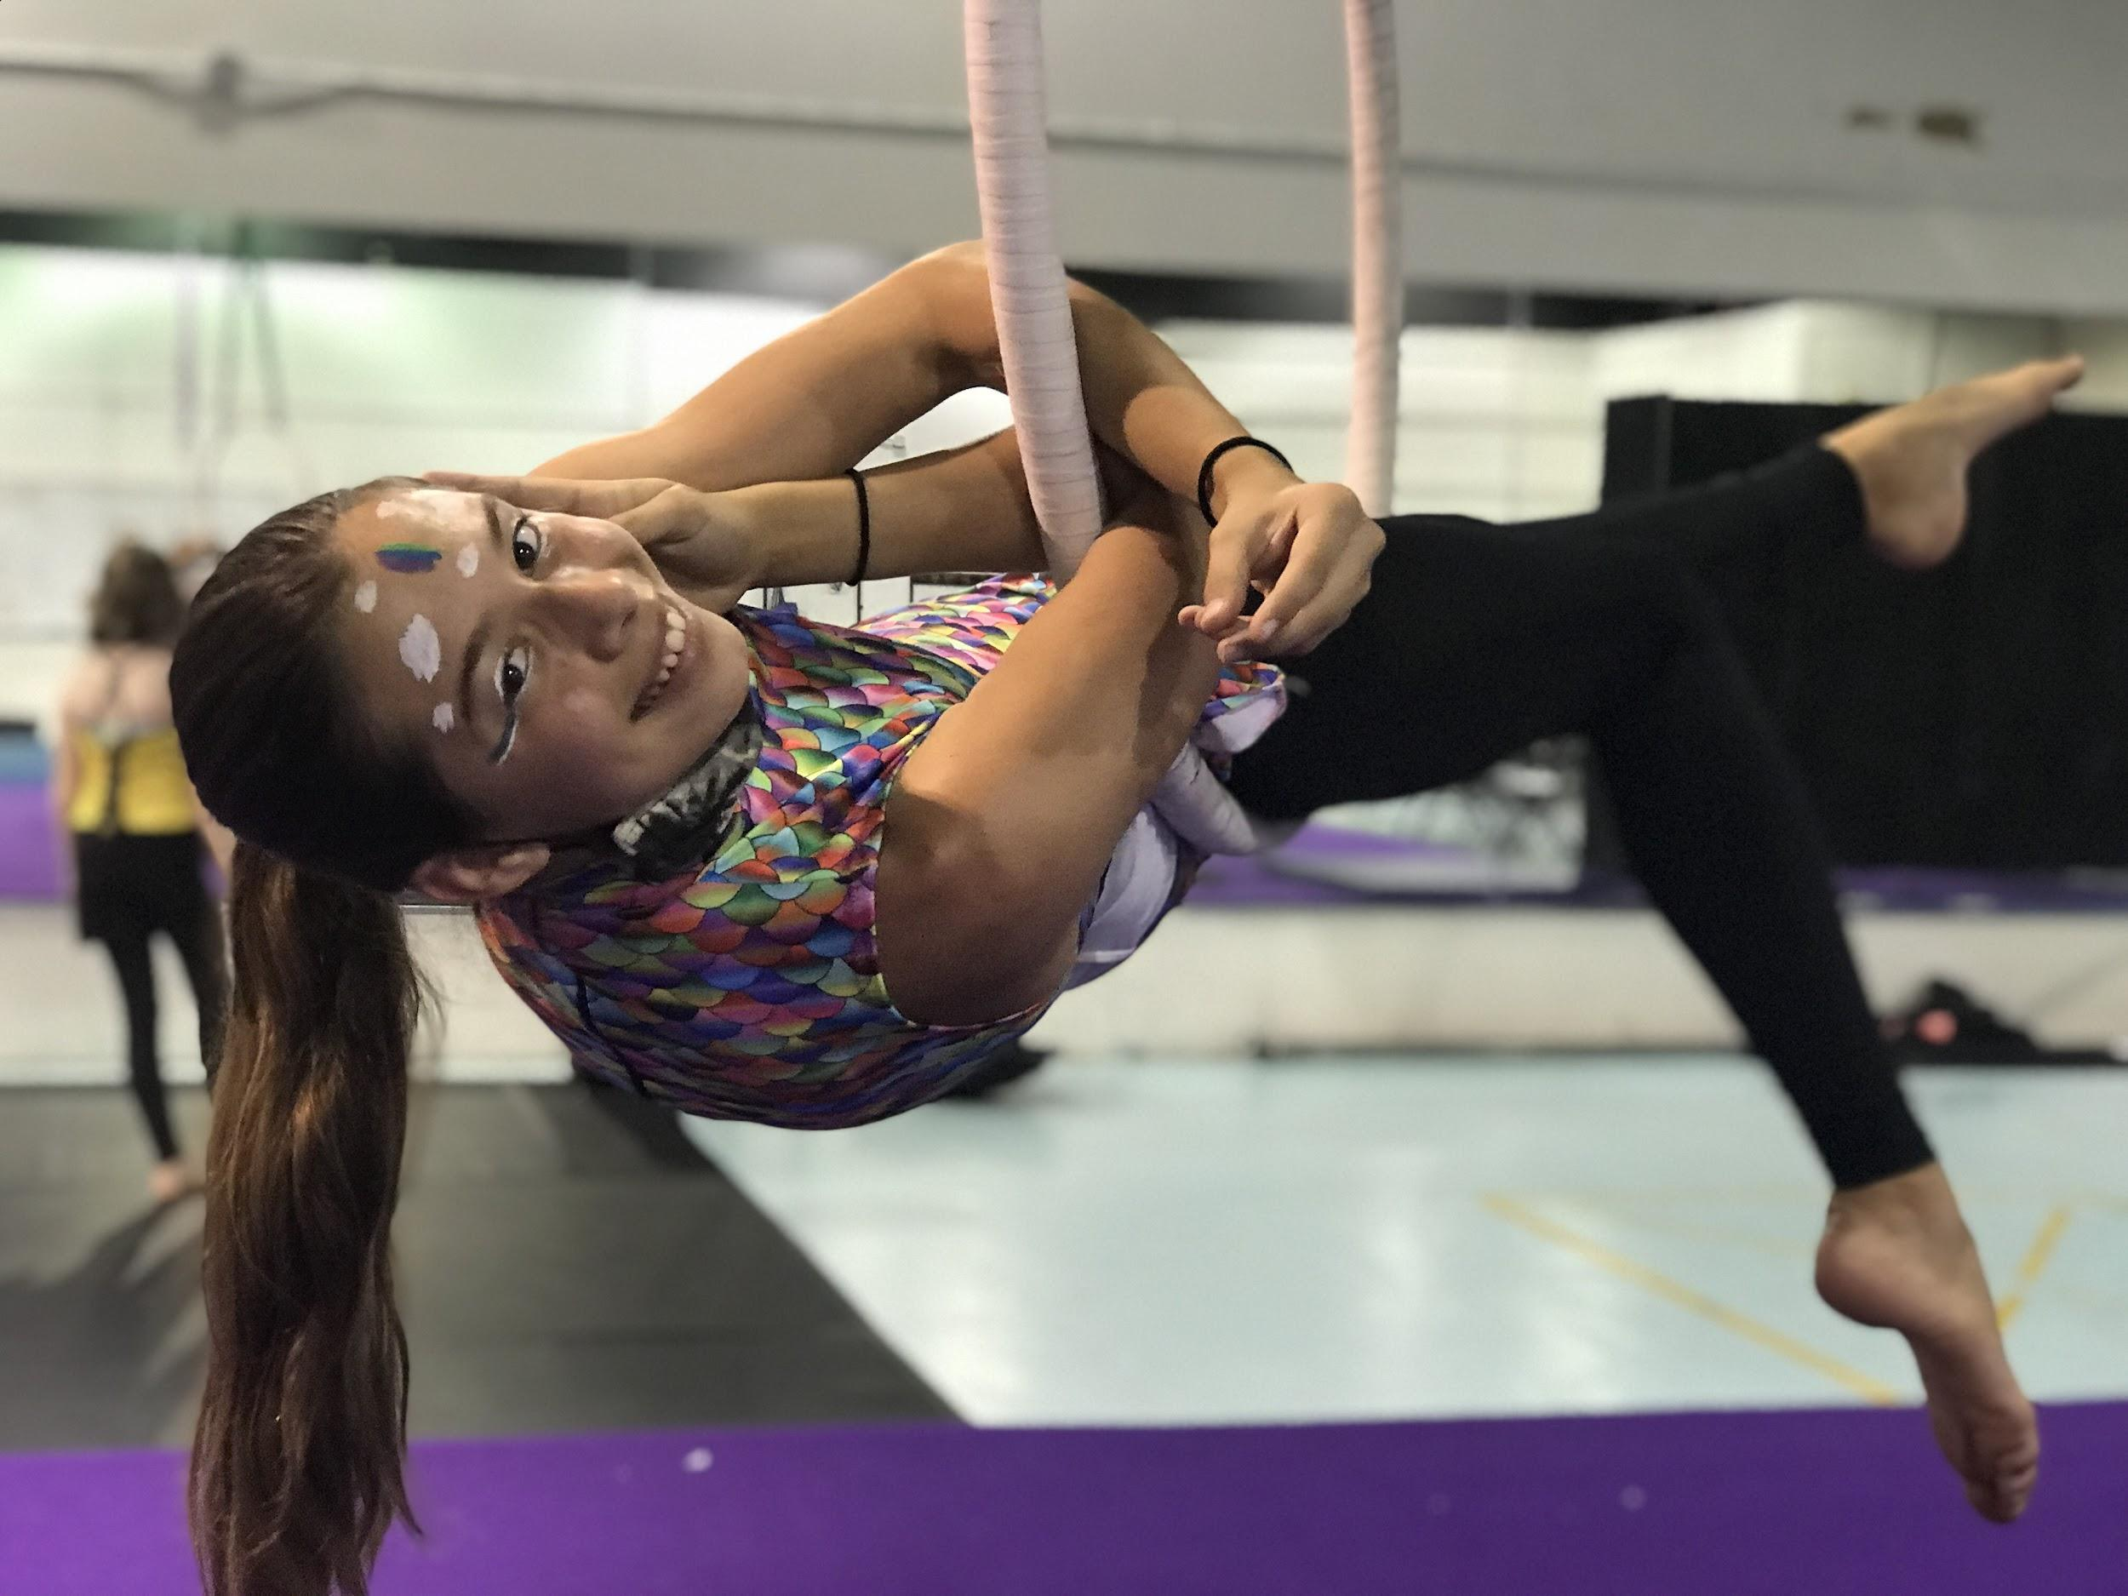
Questions?

